Slide 1
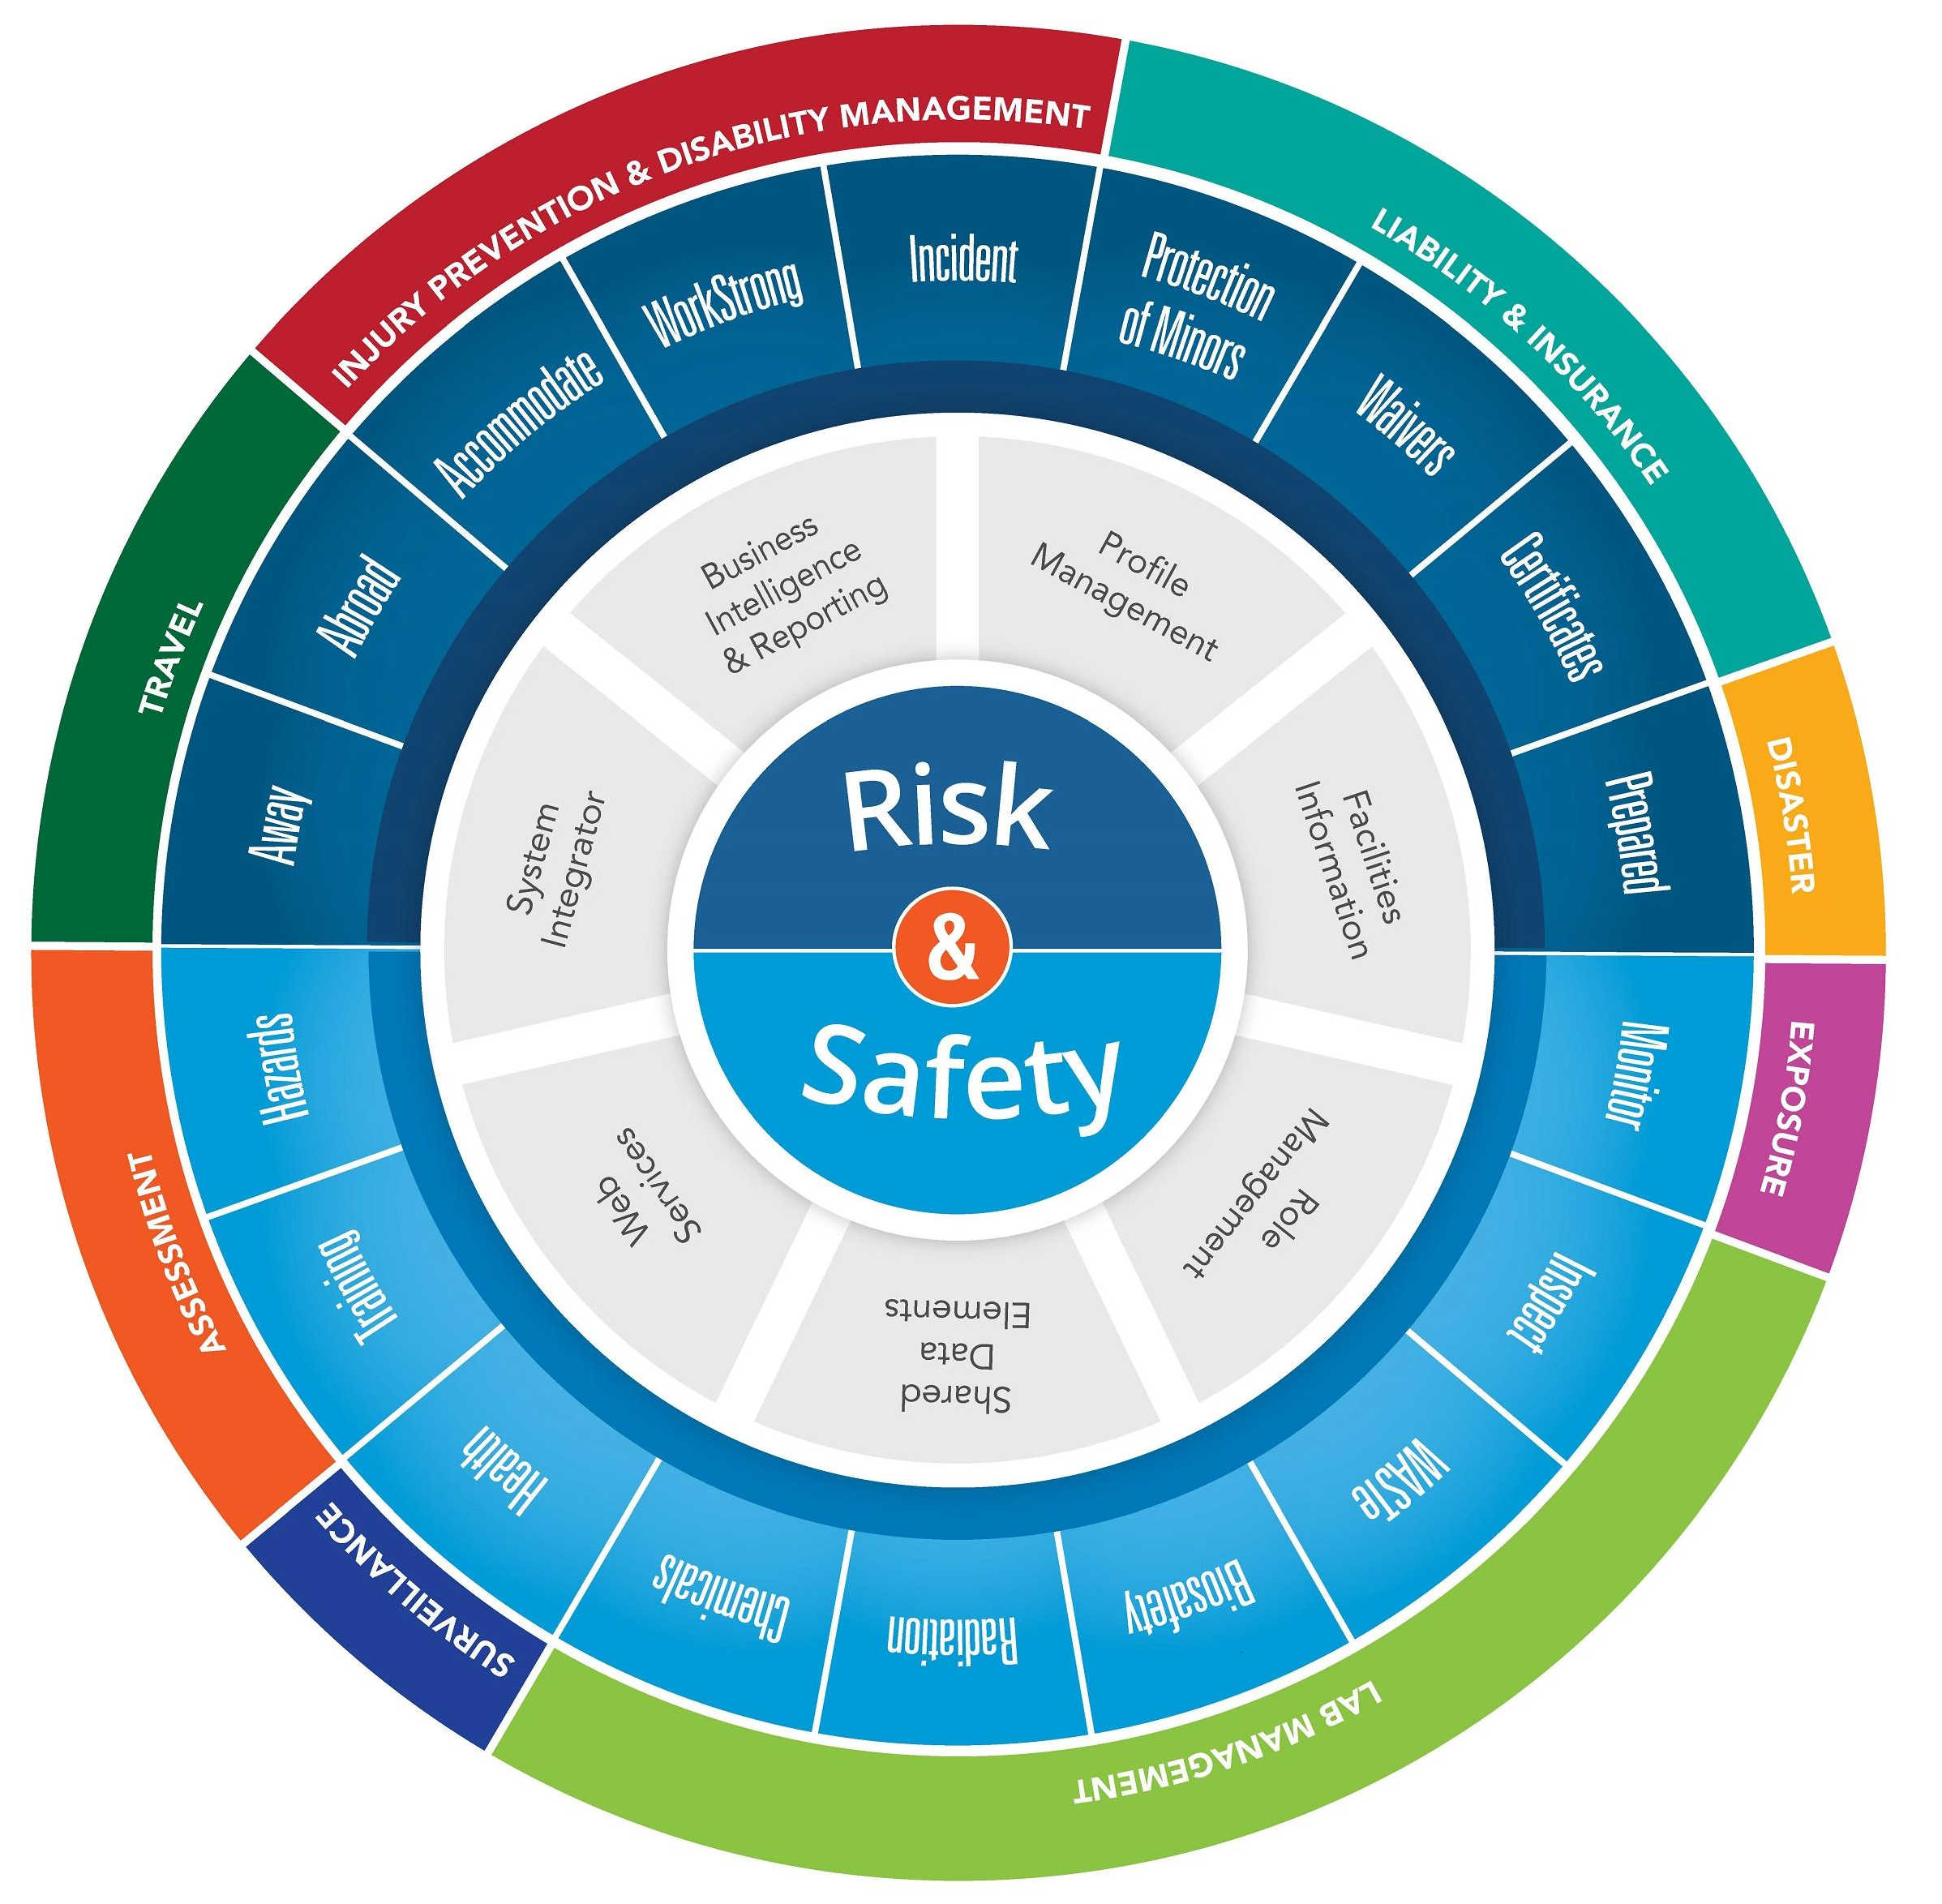
UC Risk and Safety Solutions
More than 20 different applications:
• Chemical management
• Claims management
• Hazard management
• Hazardous waste management
• Health screening
• Injury prevention
• Inspections
• Travel safety
• Use authorization management
Customers in both the public & private sector
Suite is modularized

Slide 2
Inspect
Mobile (iOS & Android) + Desktop
Flexible, can be used for any inspection type
Multiple inspectors can contribute to the same checklist
Checklist library
Off-line mode
Notification
Customizable settings
People/location management
Reports & Business Intelligence (BI) dashboard

Slide 3
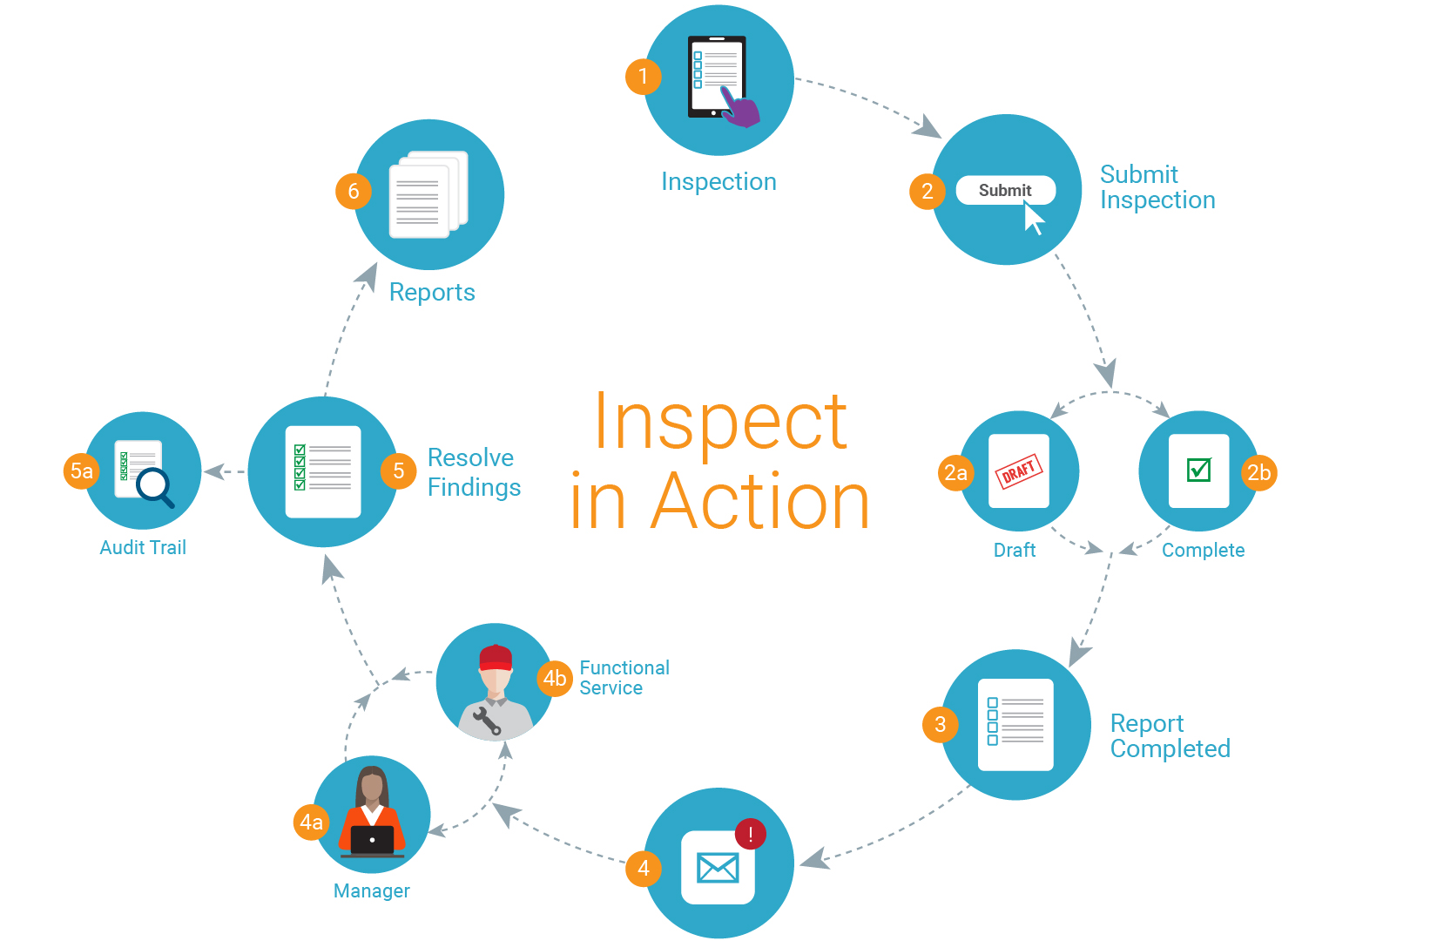

Slide 4
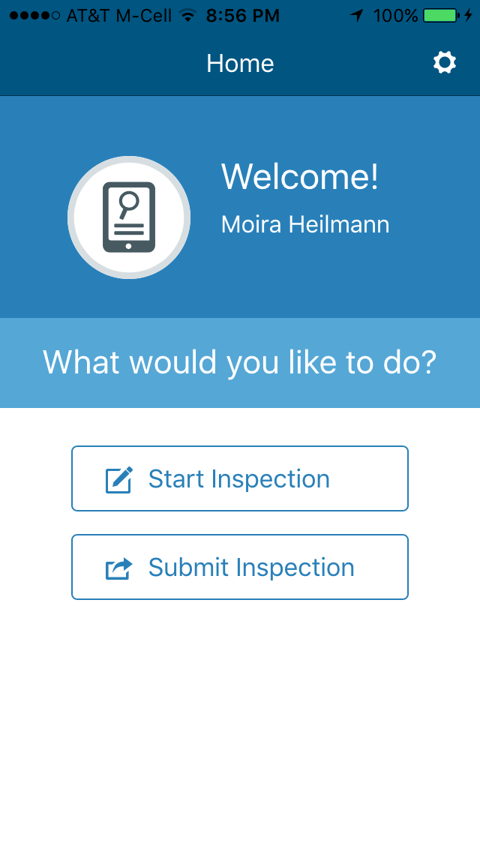
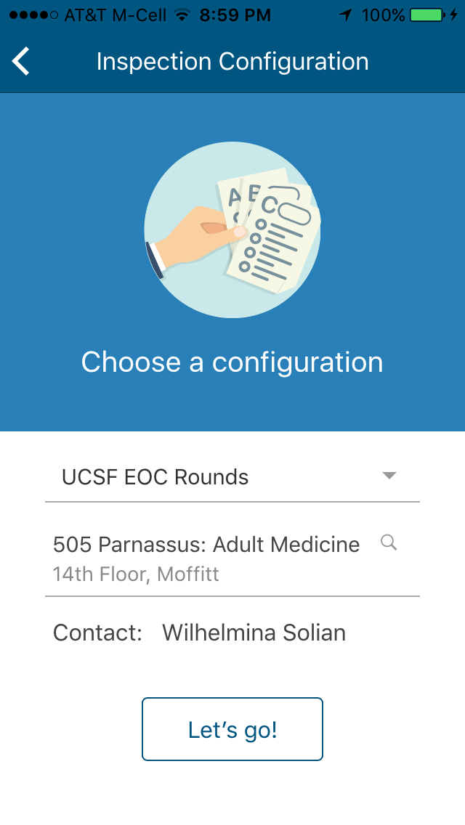
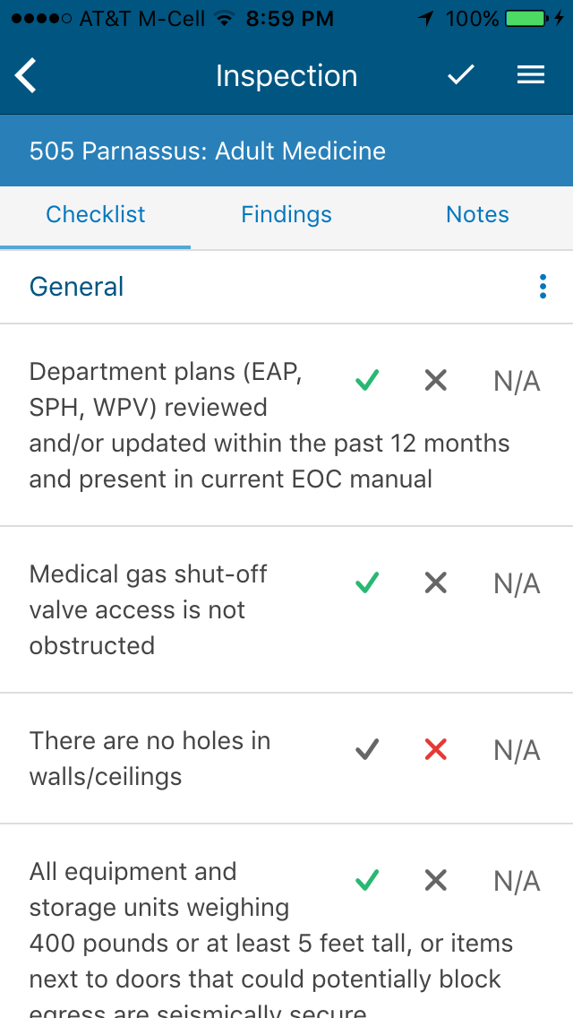

Slide 5
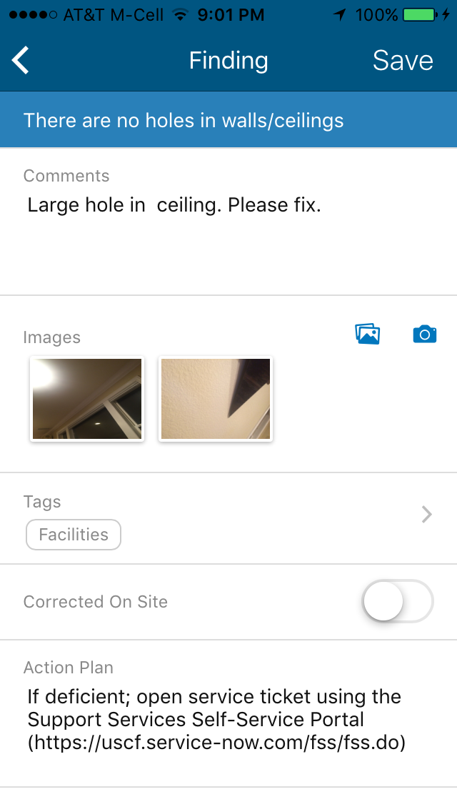
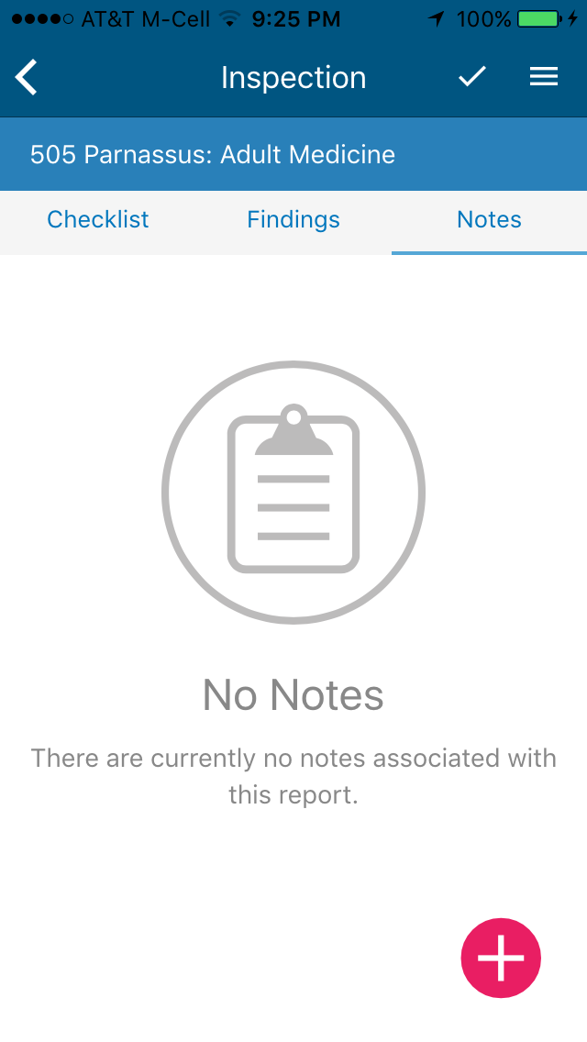

Slide 7
Desktop Interface

Slide 10
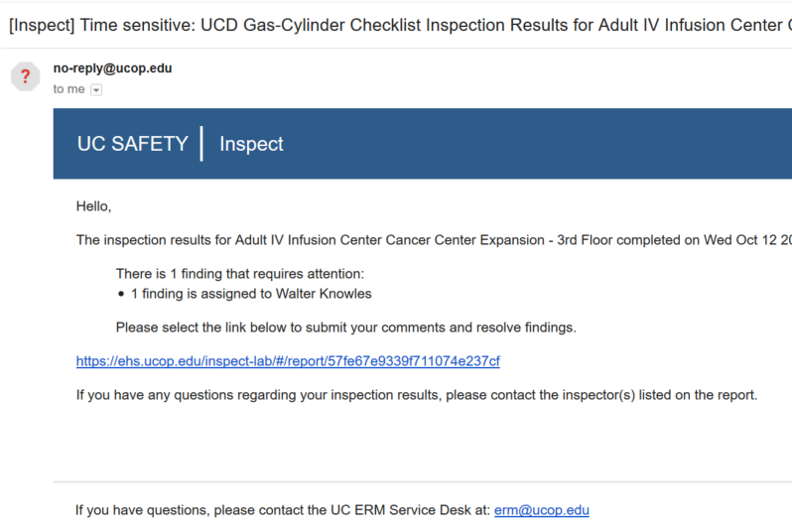
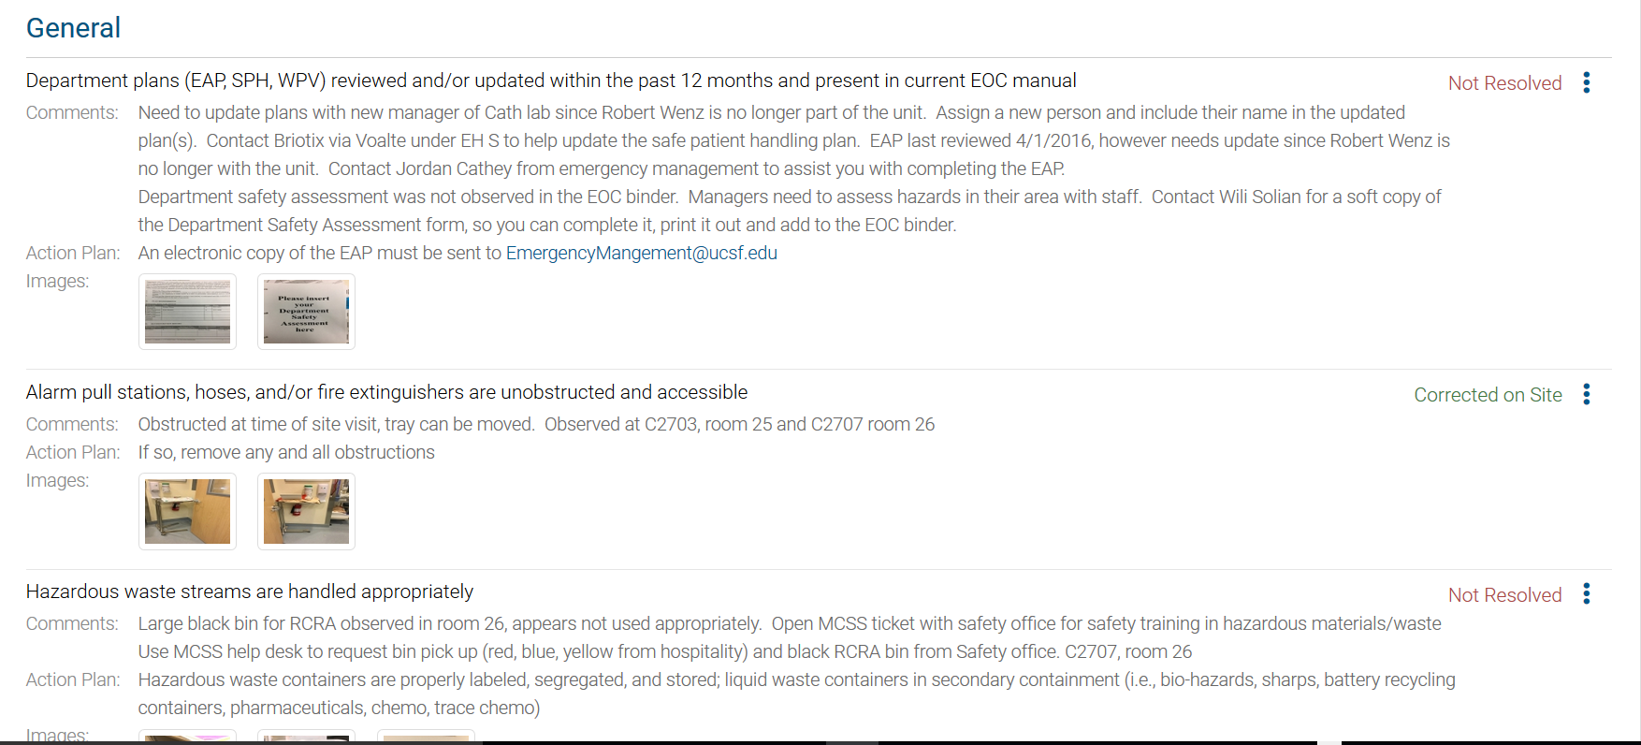
Email sent to Manager or
Functional Service
Login to Inspect & Resolve Findings

Slide 11
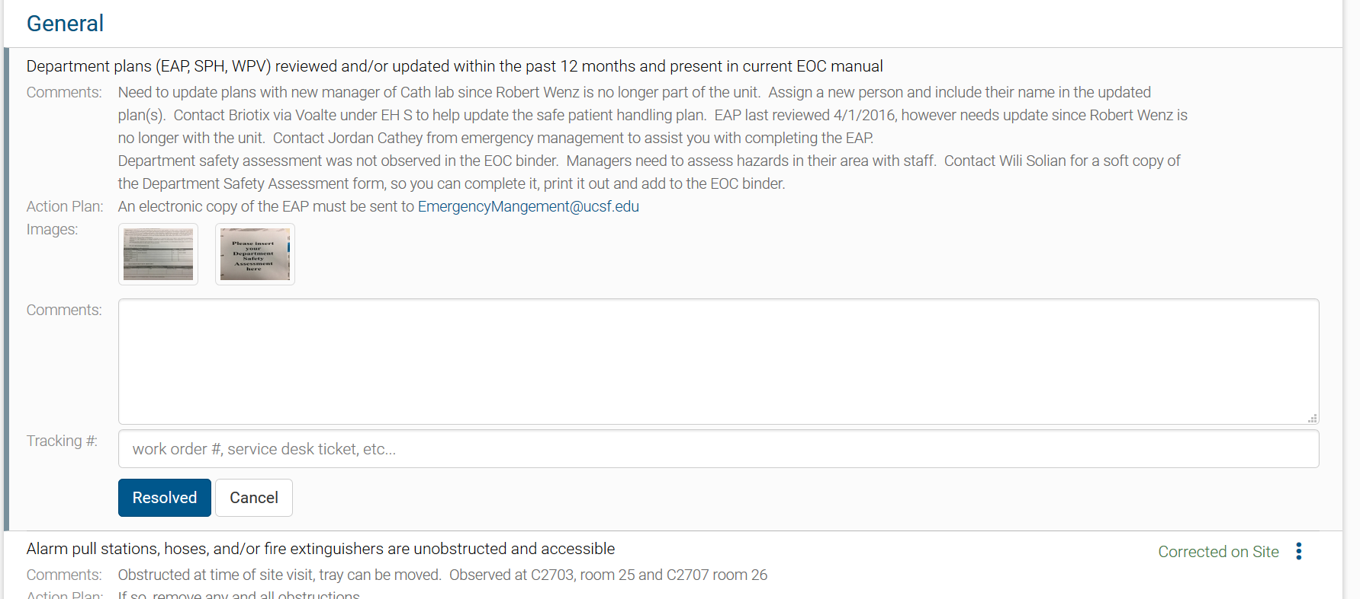

Slide 12
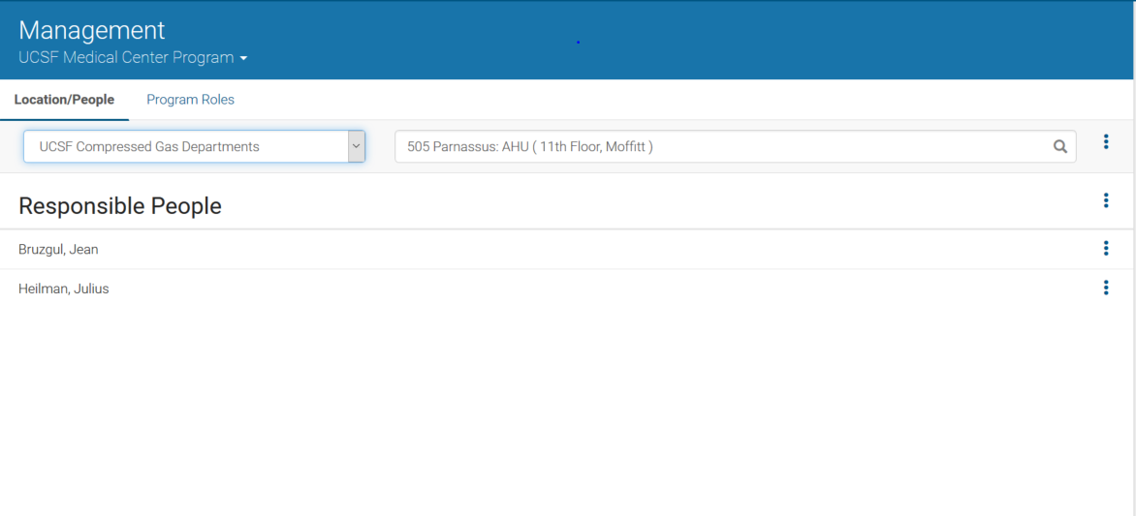

Slide 13
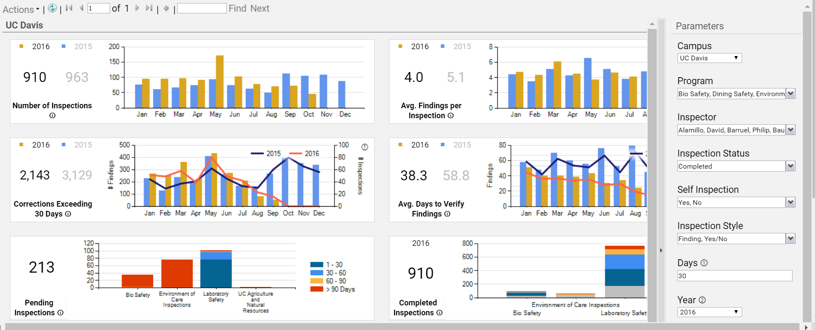
BI Dashboard

Slide 14
Testimonials
“First impression - I love it. It's so clean, easy to use, intuitive.”
Nelly, Laboratory Safety Specialist
“First impression - I love it. It's so clean, easy to use, intuitive.”
Nelly, Laboratory Safety Specialist

Slide 15
Thank You!

