Slide 1
A guide to UCSB’s Biological Safety Program
07/19/2024
https://www.ehs.ucsb.edu/programs-services/biological-safety

Slide 2
Checklist
The Biological Safety Program in the Context of Research Safety
Lab Safety and Chemical Hygiene:
Lab Safety Fundamentals – online or in person
Lab Hazard Assessment on the Risk and Safety Solutions application
Pick up lab coats prescribed by the Lab Hazard Assessment
Chemical Hygiene Plan
Training Needs Assessment Form for each group member
Update door placards with emergency contact information and lab hazards
Post emergency flipcharts
Create laboratory-specific SOPs
Complete additional training
Biological Use:
Obtain Biological Use Authorization (BUA) for projects involving certain biological materials
Organize a walkthrough with the Biosafety Officer after BUA completion
Other Institutional approvals are required for work with stem cells, vertebrates, human subjects
Notes:
Lab Safety staff will explain more on the Lab Hazard Assessment on the Risk and Safety Solutions application, Chemical Hygiene Plan

Slide 3
Biosafety Officer (BS0)
Reviews, consults on biological lab spaces
Coordinates the Institutional Biosafety Committee
Logs inspections after biological use authorization approval
Explains campus waste practices
Advises on containment practices
Provides biohazard labels and signage when needed
Provides secondary biohazardous waste collection containers, autoclave bags and accumulation bins to new faculty or those establishing a medical waste stream
Provides biohazardous sharps waste containers to new lab and field research faculty
Biosafety@ehs.ucsb.edu or Bishop@ucsb.edu
These slides are not a substitute for a discussion about your research or correspondence with the BSO, but they may answer some of your questions and serve as a reference

Slide 4
Institutional Biosafety Committee (IBC)
A requirement of the NIH Guidelines is that an Institutional Biosafety Committee (IBC) reviews and approves research that is covered by the NIH Guidelines for local review and oversight
In addition to the research covered by the NIH Guidelines, the UCSB Biosafety Committee also reviews research protocols with wild type infectious agents, human tissues and excreta
The IBC is comprised of UC Santa Barbara tenured or tenure-track faculty, subject matter experts, safety professionals, and includes unaffiliated individuals who represent community interests
IBC composition complies with the requirements of the NIH Guidelines.

Slide 5

NIH Guidelines for Research Involving Recombinant or Synthetic Nucleic Acid Molecules
Introduction:
The “NIH Guidelines for Research Involving Recombinant and Synthetic Nucleic Acid Molecules” detail procedures and practices for the containment and safe conduct of research with recombinant or synthetic nucleic acids, including research involving genetic modification of plants, animals, and microorganisms, human gene transfer, and transfer and use of genetically modified organisms.
The NIH Office of Science Policy (NIH OSP) maintains the NIH Guidelines to promote science, safety and ethics in biotechnology
As a condition for NIH funding, UC Santa Barbara ensures that such research conducted at or sponsored by our campus complies with the NIH Guidelines.
Exposure incidents involving experiments covered by the NIH Guidelines must be reported to the NIH Office of Science and Policy within 30 days

Slide 6
NIH Guidelines for Research Involving Recombinant or Synthetic Nucleic Acid Molecules
Experiments for which NIH OSP Requires Institutional Biosafety Committee Review:
Experiments involving gene drive modified organisms (NIH Office of Science Policy April 2024 guidance)
  Minimum of BSL2 containment for all gene drive modified organisms, including Saccharomyces cerevisiae
Recombinant DNA techniques requiring IBC approval as described by the NIH Guidelines for Research Involving Recombinant or Synthetic Nucleic Acid Molecules
Cloning genes that encode molecules toxic to vertebrates, e.g., cloning genes that encode for toxins such as tetanus toxin, alpha-bungarotoxin
NIH OSP requires that some projects are registered or approved by NIH OSP (see notes)
Animal experiments covered by the NIH Guidelines
Biological Select Agents and Toxins
Click here for the NIH OBA list of experiments that are exempt from IBC oversight.
Notes:
Projects requiring extramural review or approval
Deliberate transfer of drug resistance into microorganisms; not applicable to selectable markers (A1). This work requires IBC approval, RAC review, NIH Director approval.
Cloning genes that encode molecules toxic to vertebrates, with an LD50 less than or equal to 100 ng/kg requires approval from the NIH Office of Science Policy (OSP) and IBC. (B1)
Cloning genes that encode molecules toxic to vertebrates, with an LD50 less than or equal to 100 micrograms per kg, requires NIH OSP registration and IBC approval.
Gene transfer into human research participants requires IBC and IRB approvals and RAC Review. (C1)

Slide 7
Biological Use Authorizations
Principal investigators first obtain a Biological Use Authorization (BUA) from the Institutional Biosafety Committee (IBC) to conduct research with the following materials and/or strategies:
Microorganisms that cause disease in humans, animals or plants
Human or non-human primate primary cells or tissues
Human or non-human primate excreta
Recombinant DNA techniques requiring IBC approval as described by the NIH Guidelines for Research Involving Recombinant or Synthetic Nucleic Acid Molecules
Experiments involving gene drive modified organisms (NIH Office of Science Policy April 2024 guidance)
Cloning genes that encode molecules toxic to vertebrates, e.g., cloning genes that encode for toxins such as tetanus toxin, alpha-bungarotoxin
Animal experiments covered by the NIH Guidelines
Biological Select Agents and Toxins
Click here for the NIH OBA list of experiments that are exempt from IBC oversight.

Slide 8
More on Biological Use Authorizations
The PI documents project specifics and researcher safety in the BUA
BSO meets with the PI or their designee to review the lab spaces, safety equipment, signage, transport containers, disinfection and waste management practices
The IBC meets monthly during the academic year to review BUAs and amendments to BUAs that increase or introduce new risks
https://www.ehs.ucsb.edu/programs-services/biological-safety/biological-use-authorizations
Notes:
How do faculty know about BUAs?
Biosafety officer (BSO) informs Principal Investigators (PIs) of the requirement to have an approved, project-specific biological use authorization (BUA) in place prior to the start of research for work with certain biological materials.
PIs proactively contact the BSO; they usually know what is involved because they are building on years of research
BSO contacts new PIs
EHS colleagues inform BSO of new PIs working with biological materials
BSO sends out periodic email reminders via the Office of Research

Slide 9
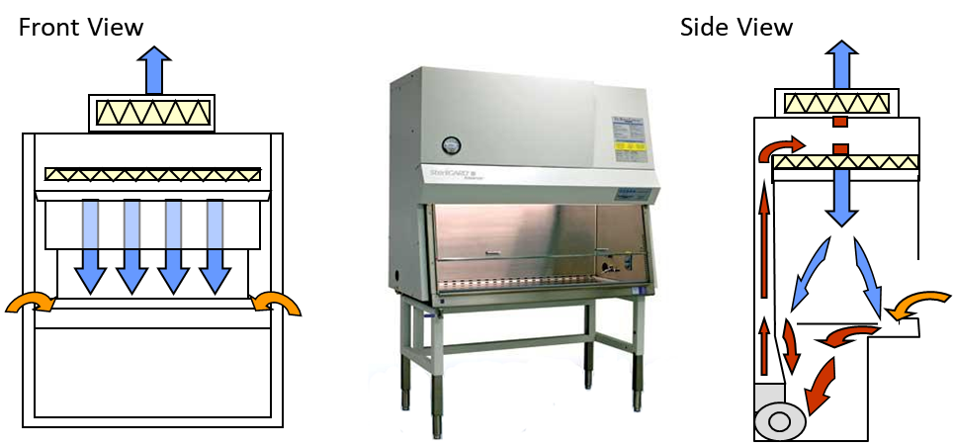
Biosafety Cabinets
Biological safety cabinets must be certified annually, and after installation, relocation, or maintenance (CCR Title 8, Section 5154.2).
The University of California has negotiated a system-wide pricing agreement with Technical Safety Services, Inc.
For 2024, the cost is $147.50 per cabinet, no travel costs. The current prices with TSS are here.
The Los Angeles field service coordinator may be reached at (562) 694-3626 or (424) 277-7607.
    Calling is preferable to emailing
Have a purchase order number from Gateway Procurement, the cabinet serial number(s) and building and room locations at the ready.
Date of certification is found on the metal sticker on the front of the unit.

Slide 10
Lab-Specific Biosafety Manual
Biological Use Authorization
Exposure control plans, as applicable
Lab-specific Standard Operating Procedures (SOPs)
Reference UCSB EHS Biosafety Guide
Biosafety in Microbiological and Biomedical Laboratories 6th ed. (CDC & NIH)
Agent summaries, as applicable, Canadian PSDS for Infectious Substances

Slide 11

Biosafety in Microbiological and Biomedical Laboratories 6th ed. (CDC & NIH)
This manual describes the combinations of standard and special microbiological practices, safety equipment, and facilities constituting biosafety levels 1-4, which are recommended for work with a variety of infectious agents in various laboratory settings.
The latest edition is augmented to cover decontamination and sterilization, biological toxins, and infectious agent summary statements.
Available for download at the bottom of the page linked above

Slide 12
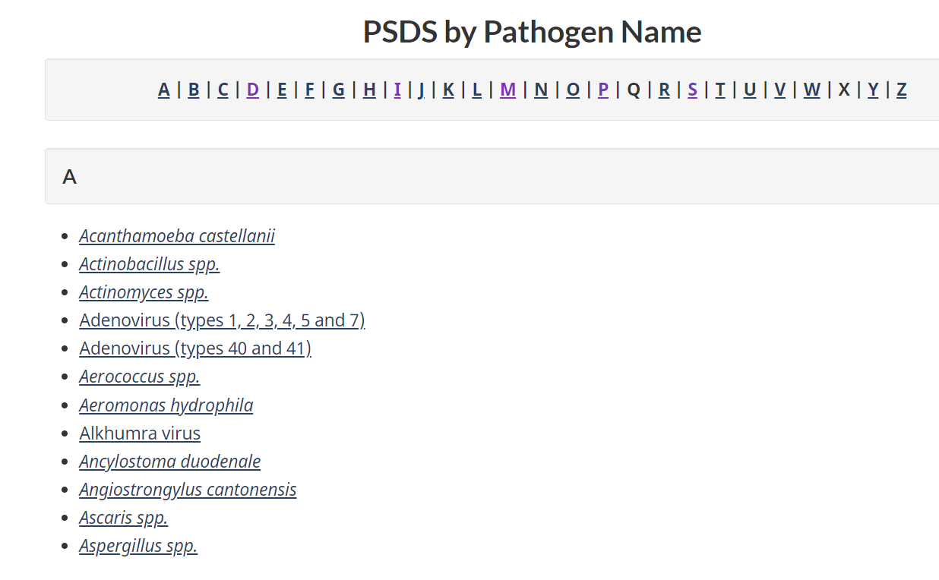
Canadian PSDS for Infectious Substances
The BUA needs to contain a summary of characteristics for the infectious substances used in the project
DHHS NIH and CDC refer to Canada’s Pathogen Safety Data Sheets, for infectious agent summaries
Summaries cover pathogenicity/toxicity, infectious dose, susceptibility to disinfectants, survival outside the host, and lab acquired infections
If an agent summary is not available, please work with the BSO to document a risk assessment of the agent(s)

Slide 13
Personal Protective Equipment: Lab Coats
Obtain 2 liquid impervious pin-striped, cuffed lab coats, so that while one is laundered, there is another available for use
Wear a cuffed lab coat at the BSC, or pull the disposable gloves up and over the cuffs
Ensure lab coats are visible clean
Store the clean lab coat in a drawer or similar, out of any splash zone
In case of gross contamination, autoclave the lab coat before dropping off for laundering
Laundered by Mission Linen
Drop off and pick up on Tuesdays at
  Chemistry (storeroom loading dock area)
  Bio 2 (1st floor corridor towards the south of the building)
Notes:
Personal Protective Equipment
Laboratory personnel shall wear disposable gloves and liquid impervious lab coats when handling blood or OPIM.
Disposable gloves are stocked in the laboratory by the PI or the Lab Safety Contact.
Gloves are replaced as soon as practical when contaminated, torn, punctured, or when their ability to function as a barrier is compromised.
Safety glasses or safety glasses plus a face shield must be worn for liquid handling outside of a biosafety cabinet.
Eyewear is surface decontaminated when the wearer is done using them. Leave disposable gloves on to decontaminate the eyewear, dampen a paper towel with freshly diluted disinfectant, wipe the interior of the eyewear and coat the exterior surfaces with disinfectant, then set aside beyond the active work area and allow to dry.
The reusable face shield is surface decontaminated when the wearer is done using it, using the steps for eyewear.
All personal protective equipment is removed prior to leaving the work area.
Assume that the outside of gloves is contaminated and remove gloves without touching the exterior surfaces. Using a gloved hand, grasp the palm area of the other gloved hand and peel off the first glove. Hold the removed glove in the gloved hand. Slide fingers of ungloved hand under remaining glove at wrist and peel off second glove over first glove. Discard gloves in a waste container and wash hands and wrists with soap and water for 20 seconds, or rub hands together with an alcohol-based hand sanitizer for 20 seconds and wash hands at the earliest opportunity.
Decide if the lab coat may be worn again or if it is time to launder it. Lab coats must be visibly clean and should be laundered once a week. Unsnap and rehang clean lab coats, or unsnap and invert the inside to the outside for lab coats that will be laundered.
Contaminated lab coats are handled as little as possible and autoclaved prior to depositing at a laundry drop off location. Autoclave grossly contaminated lab coats in a clear/white autoclave bag before depositing in the vendor laundry bin (without the autoclave bag).
Lab coats are laundered by an outside vendor, Mission Linen.
Employees must not take home lab coats for laundering.
Mission Linen will only pick up and drop off lab coats from the two locations listed below. You are welcome to bring your lab coats to either of these locations, whichever is most convenient for you. Please note: Lab coats are picked up on Tuesdays mornings and returned the following Tuesday to the same laundry drop off location.
Chemistry (storeroom loading dock area)
Bio 2 (1st floor corridor towards the south of the building)

Slide 14
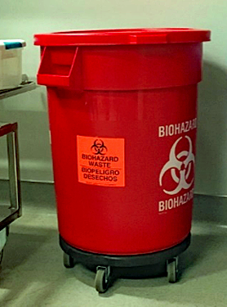
Medical Waste
Medical or biohazardous waste is regulated at the state level
California Department of Public Health (CDPH) inspects campus labs that generate biohazardous waste
The campus medical waste management plan is updated by the BSO and reviewed and approved by CDPH annually
For the current medical waste management plan and other visuals:
https://www.ehs.ucsb.edu/programs-services/biological-safety/medical-waste

Slide 15
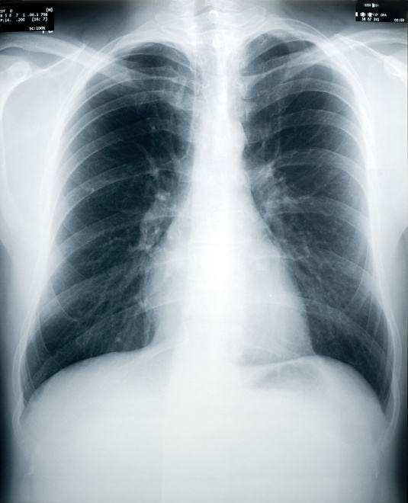
Cal/OSHA Aerosol Transmissible Diseases Standard
Most laboratory acquired infections are attributed to aerosol exposure
California state regulations cover certain pathogens that are transmissible by inhalation, aerosolization, and droplets
Standards apply to laboratory as well as field research
Several fecal-oral transmissible pathogens are included on the list, e.g., Salmonella, Shigella
Annual training requirement for personnel; initial training provided by EH&S biosafety officer and an online annual refresher
Regulations require a written, laboratory-specific Aerosol Transmissible Diseases Exposure Control Plan
“Appendix D” lists the pathogens covered for laboratory research
CCR Title 8 Section 5199
CCR Title 8 Section 5199 Appendix D

Slide 16
5199.1 Aerosol Transmissible Diseases Standard - Zoonotic
Infectious aerosol precautions are required for:
Management, capture, sampling, transportation or disposal of wild birds or other wildlife
Capturing or sampling of wildlife to screen for infection with zoonotic ATPs
A minimum of N95 filtering facepiece respirator is required if:
Presence of animal-related dusts in the environment with reasonable likelihood to present aerosol infection hazard
Increased potential of exposure to infectious aerosols, (e.g., handling animals in enclosed/indoor area)
Responding to a mortality event involving a significant number of animals

Slide 17


Select Agents and Toxins
Biological toxins are contained at biosafety level 2
Faculty need a BUA to clone or obtain preparations of biological toxins
  Cloning genes that encode molecules toxic to vertebrates, with an LD50 less than or equal to 100 ng/kg requires approval from the NIH Office of Science Policy (OSP) and IBC.
  Cloning genes that encode molecules toxic to vertebrates, with an LD50 less than or equal to 100 micrograms per kg, requires NIH OSP registration and IBC approval.
Select Agent Exclusions
Select Agents and Toxins List
42 CFR Parts 72 & 73 (CDC)
7 CFR Part 331 and 9 CFR Part 121 (APHIS)
Notes:
Title 42 Code of Federal Regulations Parts 72 & 73 (42 CFR 72, 73) Possession, Use, and Transfer of Select Agents and Toxins; Final Rule (October 2008). United States Department of Health and Human Services.
Title 7 Code of Federal Regulations Part 331 (7 CFR 331) and Title 9 Code of Federal Regulations Part 121 (9 CFR 121) Agricultural Bioterrorism Protection Act of 2002; Possession, Use, and Transfer of Biological Agents and Toxins; Final Rule (October 2008). U.S. Department of Agriculture.
Table provides the list of select agents and toxins on the National Select Agent Registry (NSAR) established by the Department of Health and Human Services (HHS) Centers for Disease Control and Prevention (CDC) and United States Department of Agriculture (USDA). The most-recent online list may be found at http://www.selectagents.gov/index.html. Listed select agents and toxins are categorized as follows:
Agents and toxins that cause disease in humans are listed by HHS CDC as:
HHS select agents and toxins that affect humans
OVERLAP select agents and toxins that affect both (or OVERLAP with) humans and animals
Agents and toxins that cause disease in agricultural animals or plants are listed by USDA as:
OVERLAP select agents and toxins that affect humans and animals
USDA select agents and toxins that affect animals
USDA Plant Protection and Quarantine (PPQ) select agents and toxins that affect plants
HHS and USDA Select Agents and Toxins
7 CFR Part 331, 9 CFR Part 121, and 42 CFR Part 73
HHS Select Agents and Toxins
Abrin
Botulinum neurotoxins
Botulinum neurotoxin producing species of Clostridium
Cercopithecine herpesvirus 1 (Herpes B virus)
Clostridium perfringens epsilon toxin
Coccidioides posadasii/Coccidioides immitis
Conotoxins
Coxiella burnetii
Crimean-Congo hemorrhagic fever virus
Diacetoxyscirpenol
Eastern Equine Encephalitis virus
Ebola virus
Francisella tularensis
Lassa fever virus
Marburg virus
Monkeypox virus
Reconstructed replication competent forms of the 1918 pandemic influenza virus containing any portion of the coding regions of all eight gene segments (Reconstructed1918 Influenza virus)
Ricin
Rickettsia prowazekii
Rickettsia rickettsii
Saxitoxin
Shiga-like ribosome inactivating proteins
Shigatoxin
South American hemorrhagic fever viruses (Flexal, Guanarito, Junin, Machupo, Sabia)
Staphylococcal enterotoxins
T-2 toxin
Tetrodotoxin
Tick-borne encephalitis complex (flavi) viruses (Central European tick-borne encephalitis, Far Eastern tick-borne encephalitis, Kyasanur Forest disease, Omsk hemorrhagic fever, Russian Spring and Summer encephalitis)
Variola major virus (Smallpox virus)
Variola minor virus (Alastrim)
Yersinia pestis
OVERLAP Select Agents and Toxins
Bacillus anthracis
Brucella abortus
Brucella melitensis
Brucella suis
Burkholderia mallei (formerly Pseudomonas mallei)
Burkholderia pseudomallei (formerly Pseudomonas pseudomallei)
Hendra virus
Nipah virus
Rift Valley fever virus
Venezuelan equine encephalitis virus
USDA Select Agents and Toxins
African horse sickness virus
African swine fever virus
Akabane virus
Avian influenza virus (highly pathogenic)
Bluetongue virus (exotic)
Bovine spongiform encephalopathy agent
Camel pox virus
Classical swine fever virus
Ehrlichia ruminantium (Heartwater)
Foot-and-mouth disease virus
Goat pox virus
Japanese encephalitis virus
Lumpy skin disease virus
Malignant catarrhal fever virus
(Alcelaphine herpesvirus, Type 1)
Menangle virus
Mycoplasma capricolum subspecies capripneumoniae
(contagious caprine pleuropneumonia)
Mycoplasma mycoides subspecies mycoides small colony (Mmm SC) (contagious bovine pleuropneumonia)
Peste des petits ruminants virus
Rinderpest virus
Sheep pox virus
Swine vesicular disease virus
Vesicular stomatitis virus (exotic): Indiana subtypes VSV-IN2 and VSV-IN3
Virulent Newcastle disease virus¹
USDA Plant Protection and Quarantine (PPQ) Select Agents and Toxins
Peronosclerospora philippinensis (Peronosclerospora sacchari)
Phoma glycinicola (formerly Pyrenochaeta glycines)
Ralstonia solanacearum race 3, biovar 2
Rathayibacter toxicus
Sclerophthora rayssiae var zeae
Synchytrium endobioticum
Xanthomonas oryzae
Xylella fastidiosa (citrus variegated chlorosis strain)
Source: NSAR list updated 09/19/2011
¹A virulent Newcastle disease virus (avian paramyxovirus serotype 1) has an intracerebral pathogenicity index in day-old chicks (Gallus gallus) of 0.7 or greater or has an amino acid sequence at the fusion (F) protein cleavage site that is consistent with virulent strains of Newcastle disease virus. A failure to detect a cleavage site that is consistent with virulent strains does not confirm the absence of a virulent virus.

Slide 18
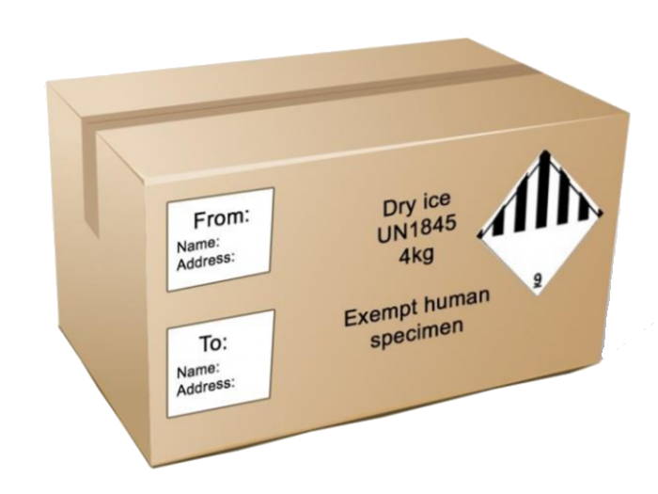
Shipping
Training and triple packaging is required for regulated biological shipments
A leakproof primary receptacle (such as a sealed cryovial, test tube, etc.)
A leakproof secondary packaging
Outer packaging of adequate strength for its capacity, weight, and intended use
For more information

Slide 19
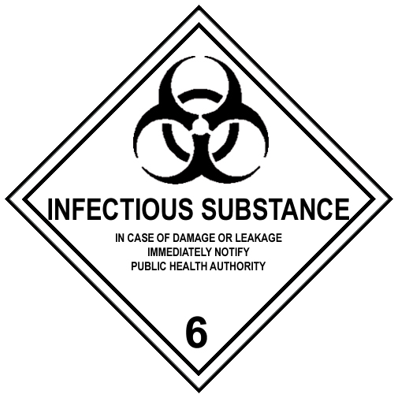
Infectious Substance Shipping
Formal training required to prepare and ship
“Category A” and “Category B” infectious substances
Some human and animal clinical specimens
are not considered dangerous goods
“Exempt Human Specimen” or “Exempt Animal Specimen”
Training is also required to ship Class 9: Miscellaneous Dangerous Goods, e.g. formalin, dry ice, Genetically Modified Microorganisms and Genetically Modified Organisms
Shipping of all dangerous goods is highly regulated by the UN, IATA Dangerous Goods Regulations, ICAO, US DOT Hazardous Materials Regulations, FAA
Regulations vary by mode of transportation and whether the shipment is crossing country boundaries
Notes:
The materials presented below are subject to DOT and IATA shipping regulations for infectious substances and genetically modified organisms:
Infectious substances are materials regulated for shipping. These materials are known to be, or are reasonably suspected to contain, an animal or human pathogen. A pathogen is a virus, microorganism (including bacteria, plasmids, or other genetic elements), proteinaceous infectious particle (prion), or a recombinant microorganism (hybrid or mutant) that is known or reasonably expected to cause disease in humans or animals. Microorganisms that are unlikely to cause human or animal diseases are not subject to biological shipping regulations.
Category A infectious substances are materials capable of causing permanent disability, or a life threatening or fatal disease in humans or animals when exposure to them occurs. Category A infectious substances are shipped as infectious substances affecting humans (UN2814) or infectious substances affecting animals (UN2900). Examples of Category A infectious substances are listed in a table in the infectious substances section of the IATA Dangerous Goods Regulations.
Category B infectious substances are materials that do not meet Category A criteria. Category B infectious substances are shipped as UN3373.
Patient specimens or diagnostic specimens are any human or animal materials including but not limited to excreta, secreta, blood, blood components, tissue, and tissue fluids being shipped for the purpose of diagnosis. Patient specimens that have a minimal likelihood of containing pathogens are regulated materials, but they are also exempt from many shipping requirements. Professional judgment is used to determine if a specimen contains pathogens and should be based on the patient’s medical history, symptoms, local conditions, and individual circumstances. The outer package must be marked “Exempt human specimen” or “Exempt animal specimen.” If there is more than a “minimal likelihood” that a patient specimen contains pathogens, it must be shipped as a Category A or Category B infectious substance.
Biological products are materials that are derived from living organisms and manufactured for use in the prevention, diagnosis, treatment, or cure of disease in humans or animals and are certified by the USDA, FDA, or other national authority. Examples of biological products include certain viruses, therapeutic serums, toxins, antitoxins, vaccines, blood, and blood products. Biological products transported for final packaging, distribution, or use by medical professionals are not subject to biological shipping regulations. Biological products that do not meet these criteria must be shipped as UN2814, UN2900, or UN3373 when appropriate.
Genetically Modified Organisms (GMO) or microorganisms (GMMO) are organisms whose genetic material has been purposely altered through genetic engineering in a way that does not occur naturally. GMOs and GMMOs that are not infectious but that can alter animals, plants, or microorganisms in a way that is not normally the result of natural reproduction are considered a miscellaneous hazard (Class 9) and are shipped as UN3245. GMOs and GMMOs that are infectious must be shipped as UN2814, UN2900, or UN3373.
H.5 References and Resources
International Air Transport Association (IATA) Dangerous Goods Regulations (DGR), Section 3.6.2, “Division 6.2 : Infectious Substances,” and Section 3.9, “Class 9: Miscellaneous Dangerous Goods, Genetically Modified Microorganisms and Genetically Modified Organisms”
US DOT Document PHH50-0079-0706
U.S. Department of Transportation (DOT) Hazardous Material Regulations (HMR), 49 CFR 171.8 (Definitions), 173.134 (Infectious Substances), and 173.6 (Materials of Trade)
U.S. Postal Service (USPS) Domestic Mail Manual Section 10.17 (Infectious Substances)

Slide 20
Training
Bloodborne Pathogens Training
This course complies with Cal/OSHA Title 8, Section 5193 BBP training requirements and is for researchers working with human and nonhuman primate tissues.
Required annually.
Biosafety Training
Introduction to safe practices for handling biological agents. This course is required prior to working with recombinant or synthetic DNA, infectious materials, infectious animals, human clinical samples and other research-related projects that require BSL-2 or enhanced BSL-2 containment practices.
Required once.
Aerosol Transmissible Diseases Training
This course complies with Cal/OSHA Title 8, Section 5199 ATD training requirements and is required for researchers working with the agents or agents plus procedures given in the regulations: https://www.dir.ca.gov/title8/5199d.html
Required annually.

Slide 21
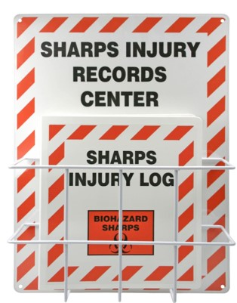
Reporting Incidents
Exposures must be reported to the PI or Lab Safety Contact immediately.
Student exposures or injuries are filed via this webpage: https://www.ehs.ucsb.edu/riskmanagement/3rd-party-incidents
Employee exposures or injuries are recorded with an Employer’s First Report: https://www.ehs.ucsb.edu/workcomp
https://www.ehs.ucsb.edu/programs-services/workers-compensation

Slide 22
Resources for Biological Safety
American Biological Safety Association Risk Group Database
American Society for Microbiology's Guidelines for Biosafety in Teaching Laboratories, 2019
Biological Safety Cabinet Basics
Biosafety in Microbiological and Biomedical Laboratories 6th ed. (CDC & NIH)
California Department of Public Health Medical Waste Training Materials
Canadian PSDS for Infectious Substances
Database of Lab Acquired Infections
Environmental Protection Agency-Registered Disinfectants
Guidelines for Disinfection and Sterilization in Healthcare Facilities, 2008 (CDC)
MCDB Autoclave Guidelines 5-23-14
NIH Guidelines for Research Involving Recombinant or Synthetic Nucleic Acid Molecules (NIH)
National Select Agent Registry List (CDC)
Review of Lab Acquired Infections, 1979-2015
Safe Work Practices for Working with Wildlife - USGS
World Health Organization Laboratory Biosafety Manual, fourth edition
Notes:
https://www.ehs.ucsb.edu/programs-services/biological-safety/resources

Slide 23
Regulations Pertaining to Biological Safety
Subject | Citation and hyperlinks
Bloodborne Pathogens | 29 Code of Federal Regulations (CFR) 1910.1030 (OSHA) California Code of Regulations (CCR) Title 8 Section 5193 (Cal/OSHA)
California Medical Waste Management Act | California Health and Safety Code, Section 117600-118360
Biosafety Cabinets | CCR Title 8 Section 5154.1
Respiratory Protection | 29 CFR 1910.134 CCR Title 8 Section 5144
Aerosol Transmissible Diseases | CCR Title 8 Section 5199
Aerosol Transmissible Diseases - Zoonotic | CCR Title 8 Section 5199.1
CDC and APHIS Select Agents and Toxins | 42 CFR Parts 72 & 73 (CDC) 7 CFR Part 331 and 9 CFR Part 121 (APHIS)
Shipping Infectious Substances | US DOT Transporting Infectious Substances Safely Packing and Shipping Dangerous Goods: What the Laboratory Staff Must Know
NIH Guidelines on Research Involving Recombinant or Synthetic Nucleic Acids | NIH Guidelines on Research Involving Recombinant or Synthetic Nucleic Acids

