Slide 1

UC Inspect

Slide 2
How does UC Inspect help improve safety at UCSB?
Central repository for all safety inspections across campus
Streamlines inspection process and eliminates duplicative work
Provides metrics and helps in prioritizing improvements
Ensures compliance, best practices, and standard alignment across the enterprise
Proactively identifies deficiencies and tracks corrective action

Slide 3
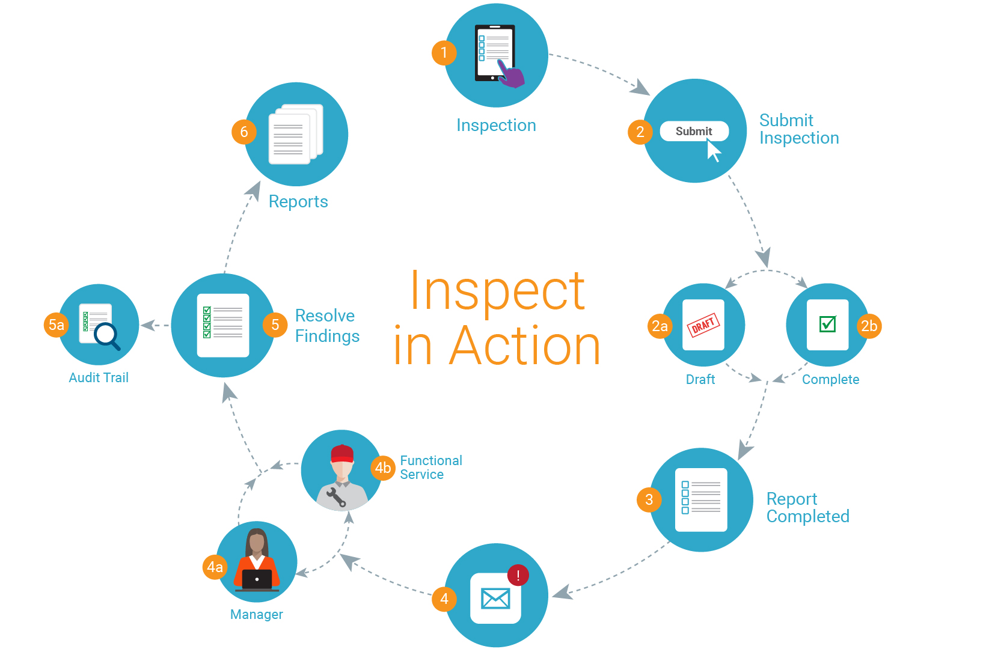

Slide 4

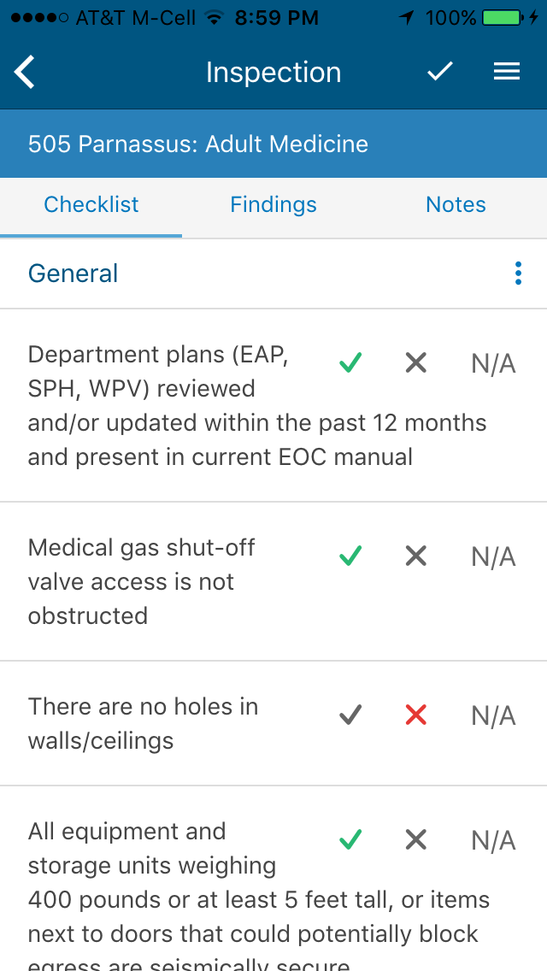
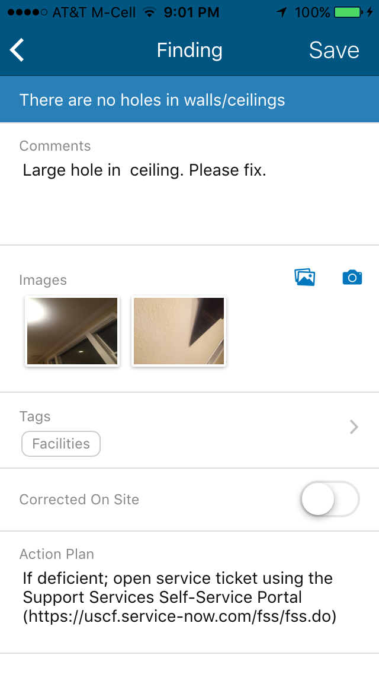
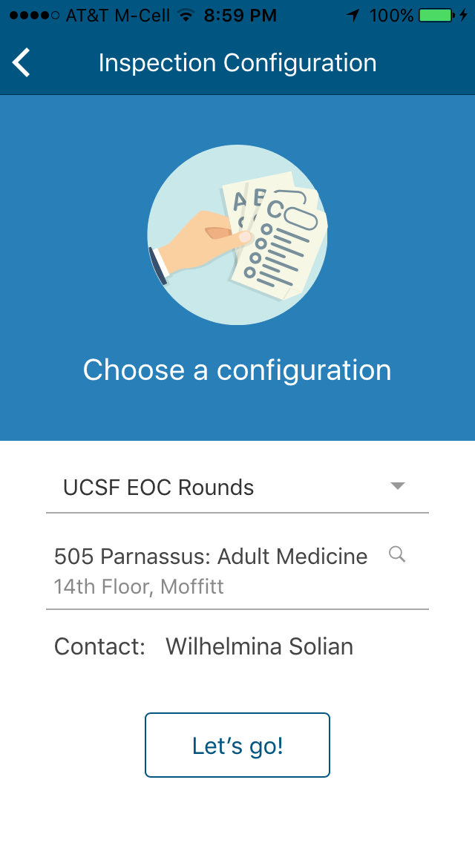
Mobile App
Simplifies and shortens inspection process
Attach photos to findings for clarification
Talk-to-text feature saves inspectors time

Slide 5

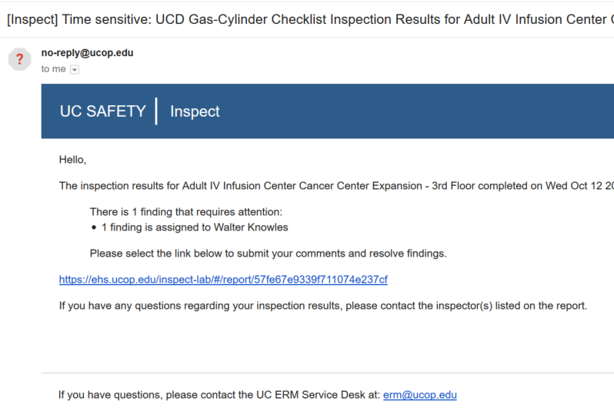
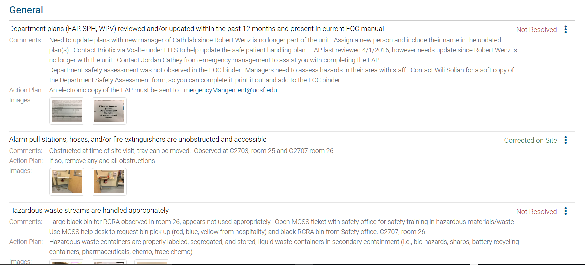
After the inspection:
Email sent to Manager or
Functional Service
Login to Inspect & Resolve Findings

Slide 6
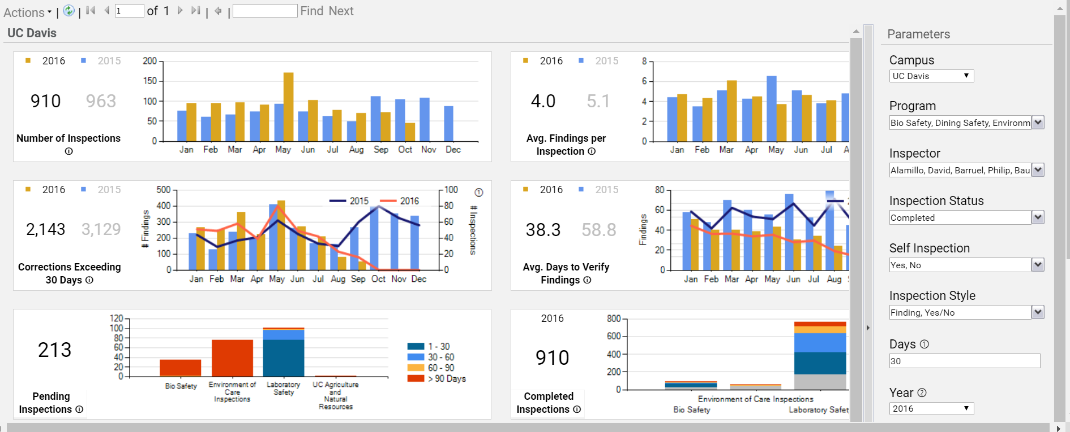
After the inspection:
Identify trending issues
Track compliance data
Track resolution times
Compare data across safety specialties
Analytics Dashboard
Please contact Rick Alvarado at ext. 5407 for system specifics, department training or questions.

