Slide 1
Valley Fever Awareness
California AB 203 (Oct. 2019)

Slide 2
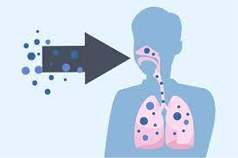
What Is Valley Fever?
Valley Fever is a fungal infection (disease) caused by the pathogenic fungus Coccidioides immitis
Fungal spores live within the top 2 to 12 inches of soil throughout much of California and the Western United States
When soil is disturbed, spores can become airborne and inhaled, possibly leading to serious health issues
Notes:
Coc-cidioides-im-mi-tis

Slide 3
Training Requirements
Supervisors are responsible for ensuring employees receive documented Valley Fever Awareness training (such as this) annually, if:
Employees work at worksites in Counties where Valley Fever is highly endemic, including Fresno, Kern, Kings, Madera, Merced, Monterey, San Joaquin, San Luis Obispo, Santa Barbara, Tulare, and Ventura. (Highly endemic means that the annual incidence rate of Valley Fever is greater than 20 cases per 100,000 persons per year.), and;
Perform activities that can be reasonably anticipated to result in exposure to substantial airborne (visible) dust for a total duration of one hour or more on any day.
Additional training materials and resources also available through the UCSB Learning Center and the UCSB EH&S Valley Fever Website.

Slide 4
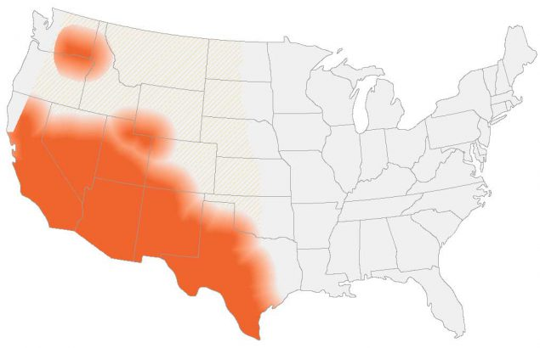
Valley Fever Risk Factors
Geographic Location (Highly endemic: Fresno, Kern, Kings, Madera, Merced, Monterey, San Joaquin, San Luis Obispo, Santa Barbara, Tulare, and Ventura counties)
Type of Work
Environmental Conditions
Personal Risk Factors

Slide 5
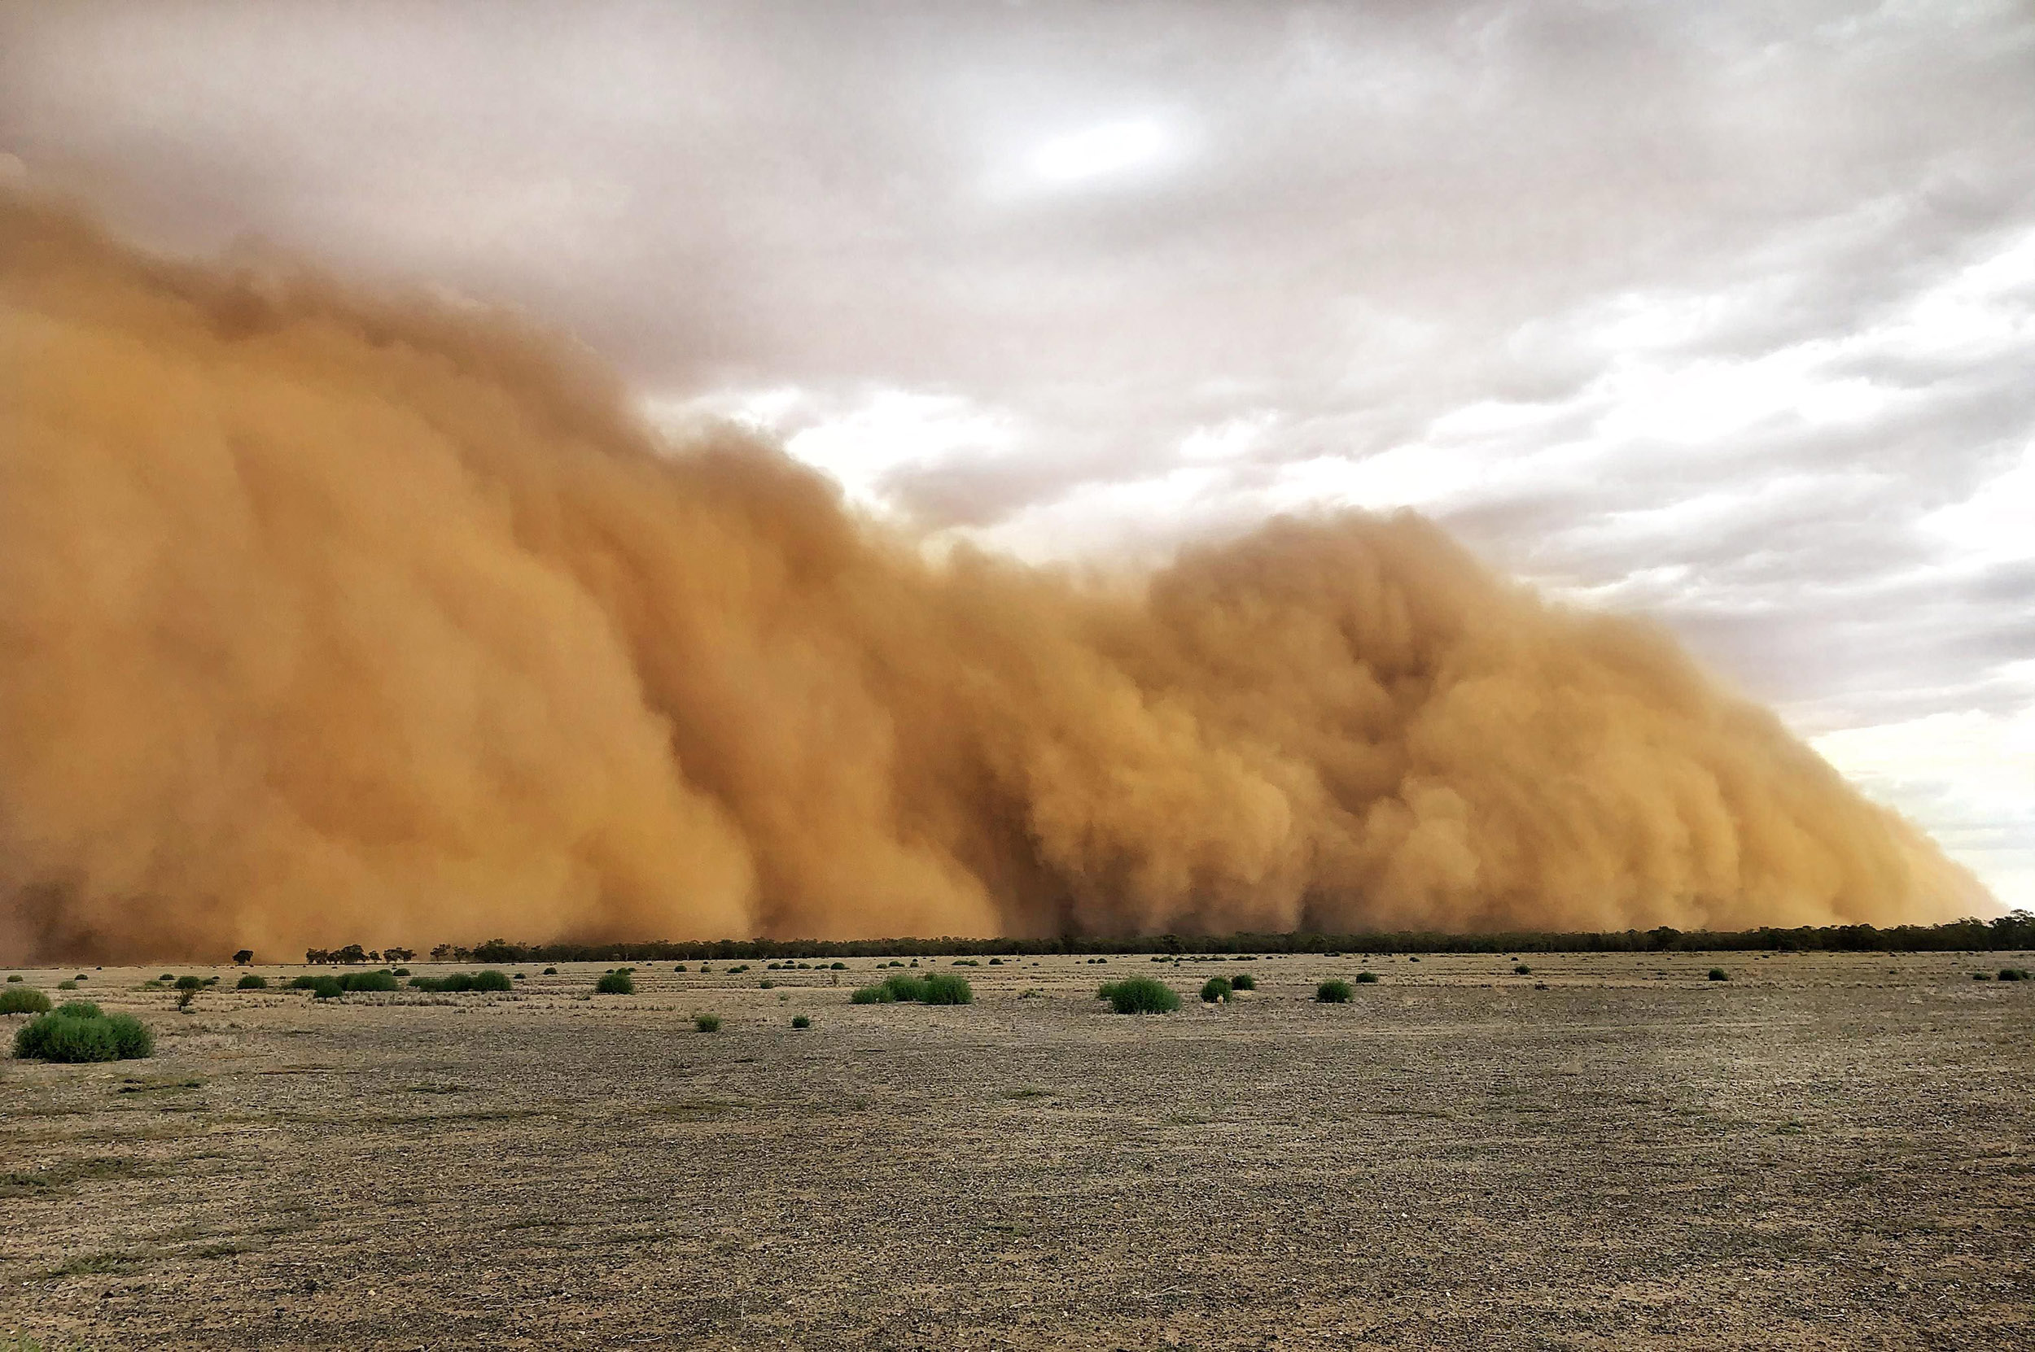
High Risk Conditions
Dry soil
Windy
Soil disturbance
Prolonged exposures to visible airborne dust
Cultivated irrigated soil may be less likely to contain the fungus compared to undisturbed soils***

Slide 6
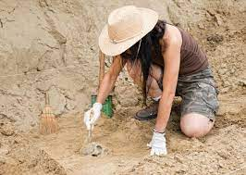
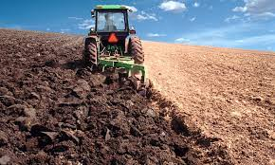
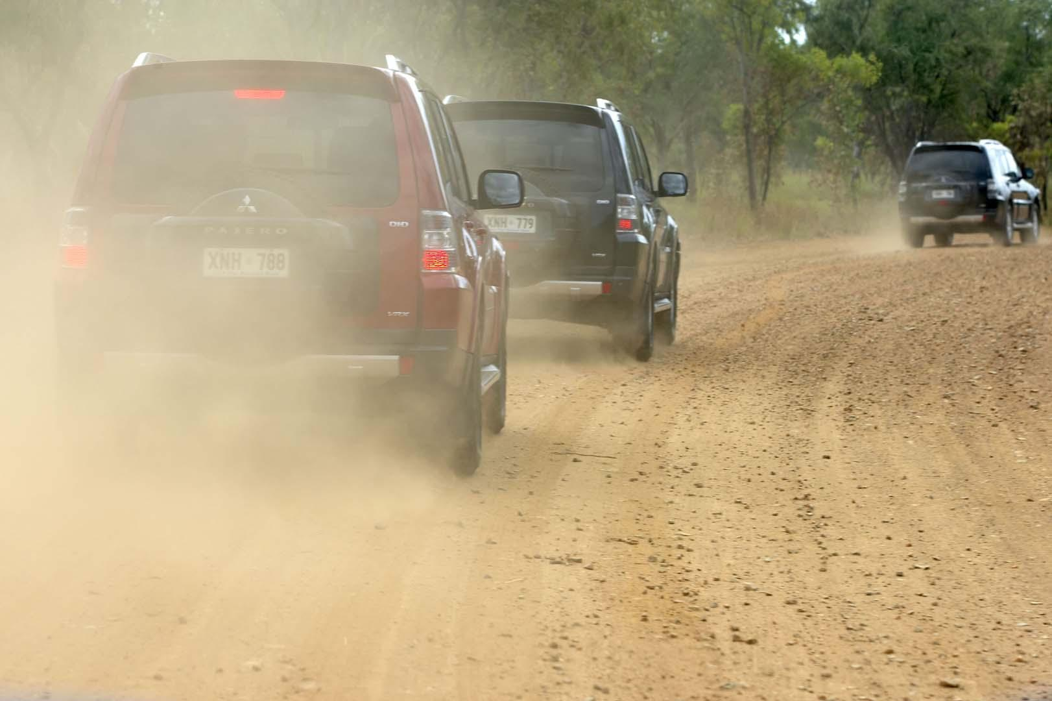
High Risk Activities

Slide 7
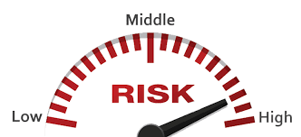
Personal Risk Factors
Conditions that may create a higher risk for some individuals include:
Pregnancy
Diabetes
Compromised immune system
HIV/AIDS)
Organ transplant
Immunosuppressant drugs (corticosteroids or tumor necrosis factor inhibitors)
Age (older adults are more likely to develop valley fever)
Race (people of Filipino and African heritage are more susceptible to developing serious fungal infections)

Slide 8
Exposure Prevention Methods
Develop a site plan and work practices that minimize soil disturbance and maximize ground cover.
Use water, soil stabilizers, and/or re-vegetation to reduce airborne dust.
Work upwind from dust disturbance
Suspend work during heavy winds
Limit contamination (food, drinks, clothes, etc.)
Wet cleaning of dusty equipment
Practice good hygiene when skin or clothing are soiled by dust
Respiratory protection (N95 or greater, requires EH&S approval) when prolonged exposure to dust cannot be avoided

Slide 9
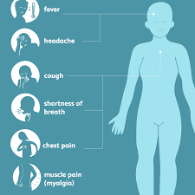
Common Signs and Symptoms
Fatigue
Cough
Fever
Shortness of breath
Headache
Muscle aches
Joint pain
Rash on upper body or legs
Symptoms similar to a flue that lingers longer than usual.

Slide 10
Treatment and Prognosis
Early detection important. Report symptoms to your supervisor immediately and seek medical attention, especially if symptoms last longer than a week.
Proper diagnosis - healthcare providers may require information about medical and travel history, and need to perform physical examinations and laboratory tests for proper diagnosis
Not contagious, you cannot spread it to others.
For many people, the symptoms of Valley fever are mild and go away naturally.
In some cases, antifungal medication may be required to reduce the severity of symptoms and prevent the infection from spreading.

Slide 11
Questions and Additional Resources
UCSB Valley Fever Website: https://www.ehs.ucsb.edu/ih/valley-fever
Contact: bickley@ucsb.edu

