Slide 1
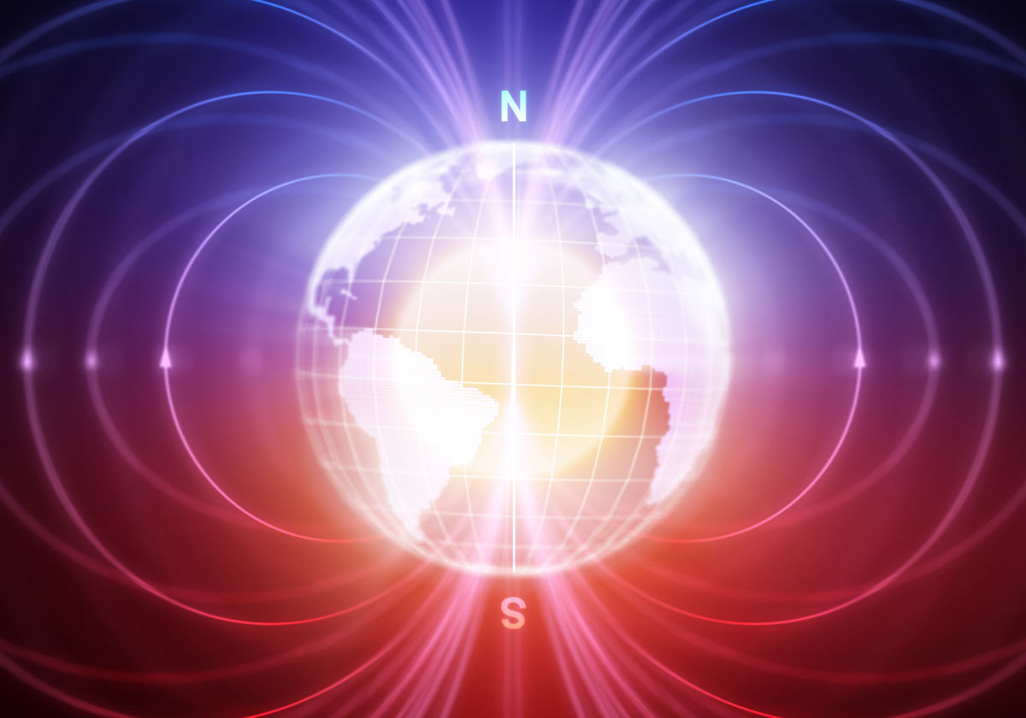
Magnetic field safety
UCSB EH&S Radiation Safety Office

Slide 2
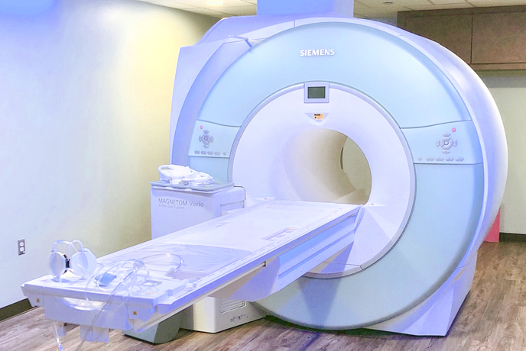
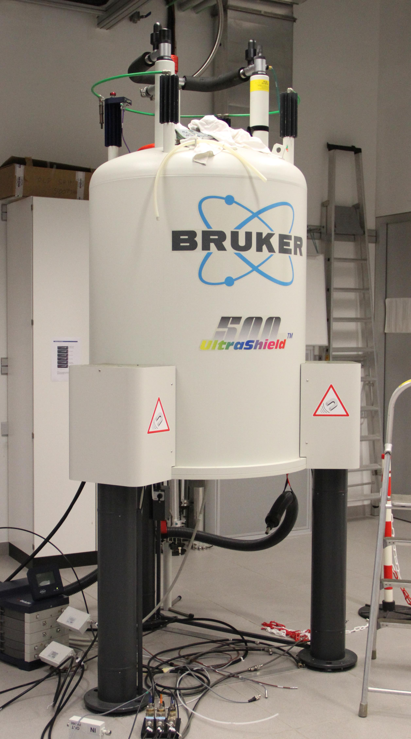
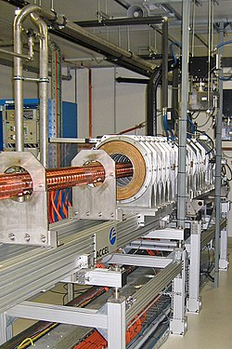
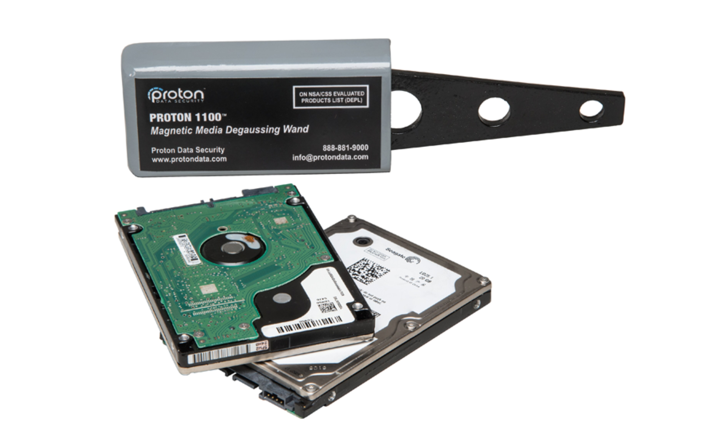
Magnetic field safety
scope
This training applies to all users of devices and equipment designed to generate magnetic fields, both static and time varying.
Some common examples include:
MRI (magnetic resonance imaging)
NMR (Nuclear magnetic resonance)
Particle accelerators
Degaussers
UCSB EH&S Radiation Safety Office

Slide 3
Magnetic field safety
Definitions & conversions
H Field: Magnetic field strength, measured in amps per meter (A/m)
B Field: Magnetic flux density. This quantity is considered the better measure of health hazards than the H field. The units are tesla (T) and gauss (G)
E Field: Electric field strength, measured in volts per meter (V/m)
_________________________________________________________________________
1 μT = 0.7958 A/m
1 A/m = 1.257 μT
1 T = 10,000 gauss = 1 weber/m²
UCSB EH&S Radiation Safety Office

Slide 4
Magnetic field safety
Magnetic Field Characteristics
Magnetic fields:
Are produced by electric currents
Cannot be detected by natural senses
Measured in units of tesla (T) or gauss (G)
1 T = 10,000 G
Decreases in strength with distance from the device
Are usually continuously being produced by the device, even when not in operation
UCSB EH&S Radiation Safety Office

Slide 5
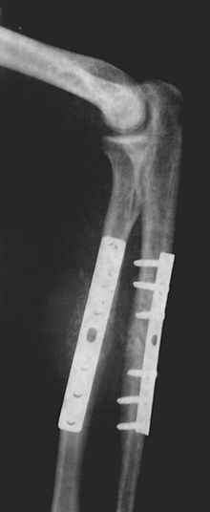
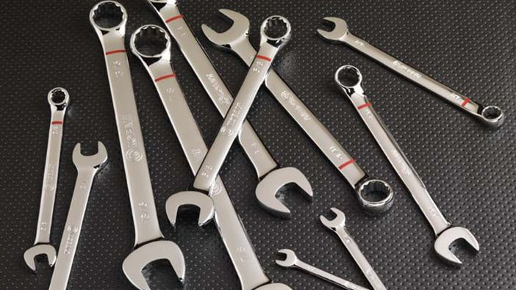
Magnetic field safety
Health & Safety concerns
Physical effects: static and time varying fields
Magnetic fields can interfere with the operation of medical implants (e.g. pacemakers, etc.), resulting in serious injury or death
Magnetic fields can also exert forces on ferromagnetic medical implants (e.g. aneurysm clips, bone plates and screws, etc.), resulting in serious injury or death
Magnetic fields can also exert forces on ferromagnetic tools, jewelry and objects, creating dangerous projectiles that can result in serious injury or death, and can damage expensive equipment
UCSB EH&S Radiation Safety Office

Slide 6
Magnetic field safety
Partial List of affected Implants (consult your physician if unsure about any implants)
Implanted cardiovascular defibrillator | Electronic implant or device | Ear implant
Magnetically-activated implant or device | Cardiac pacemaker | IV access port
Vascular access port and/or catheter | Spinal cord stimulator | Shunt
Artificial heart valve, coil, filter or stent | Internal electrodes or wires | Tissue expander
Neurostimulator and/or Biostimulator | Any type of prosthesis | Aneurysm clip(s)
Bone growth/bone fusion stimulator | Insulin or other infusion pump | Cardiac pacemaker
Artificial eye or eyelid spring | Heart valve prosthesis | Penile implant
Radiation (brachytherapy) seeds or implants | Artificial or prosthetic limb | Hearing aids
Surgical staples, clips, surgical mesh or metallic sutures | Intrauterine device (IUD), diaphragm or pessary | Wire mesh implant
Bone/joint pin, screw, nail, wire, plate, etc. | Vascular access port and/or catheter | Wig/hair implants
Dentures, false teeth, retainers, braces, partial plates and other metallic dental work | Any metallic fragment or foreign body | Implanted drug pump
Body piercing, tattoo or tattooed makeup | Joint replacement (hip, knee, etc.) | Other implants
UCSB EH&S Radiation Safety Office

Slide 7
Magnetic field safety
Health & Safety concerns
Biological effects: static fields
Cancer?
The ability of static fields to cause cancer and other biological effects is greatly disputed. There is currently no scientific consensus opinion on this issue. However, some conservative exposure limits are proposed based on the best available data.
Effects on the Heart
Based on data from MRI usage, static fields may cause a small, reversible effect on electrocardiogram data. The cause is the interaction of moving blood and the field in the heart. The effect was minimal below about 2 T (20,000 G) and is not considered a concern.
UCSB EH&S Radiation Safety Office

Slide 8
Magnetic field safety
Health & Safety concerns
Biological effects: time varying fields
Induced electrical current
An electric current can be induced when a conductor (e.g. human body) is in a time varying field.
Usually this is not a concern, but pacemaker users could be at risk. The induced currents may cause the pacemaker to incorrectly start pacing or even prevent pacing when it is actually needed.
Changes in the threshold for nerve and muscle action
Can occur when current densities are at or above 100 mA/m²
The magnetic field required to generate 100 mA/m² is very large. (10T/sec or 100,000 G/sec)
Local Heating (MRI)
Caused by the radiofrequency range time varying field
Locally deposited extra heat can cause burns
Low frequency fields generally do not contribute
UCSB EH&S Radiation Safety Office

Slide 9
Magnetic field safety
Magnetic field exposure limits
Static fields
UCSB recognizes thresholds published by the American Conference of Governmental Industrial Hygienists (ACGIH) Threshold Limit Values (TLV) data
ACGIH emphasizes that: “These values should be used as guides in the control of exposure to static magnetic fields and should not be regarded as fine lines between safe and dangerous levels.”
G – Gauss; a unit of magnetic field intensity, T – Tesla; magnetic field strength mT – millitesla | TWA – time weighted average
50,000 G (5T) | Extremity ceiling limit (no exposure allowed above this limit)
20,000 G (2T) | Extremity ceiling limit (no exposure allowed above this limit)
6000 G (600mT) | Allowed TWA for routine exposure (extremities) (8-hour TWA*)
600 G (60mT) | Allowed TWA for routine exposure (whole body) (8-hour TWA*)
30G (3.0mT) | Kinetic energy hazard from small ferrous objects
10G (1.0mT) | Damage to watches, credit cards, magnetic tape, and computer disks
5 G (0.5mT) | Highest allowed field for implanted cardiac pacemakers
UCSB EH&S Radiation Safety Office

Slide 10
Magnetic field safety
Magnetic field exposure limits
Time Varying Fields (ACGIH)
General Public
Exposures to 50/60 Hz for those with pacemakers should not exceed 0.1 mT (1 G). Other frequencies retain 0.5 mT (5G) limit.
Whole Body
50/60 Hz: 0.5 mT (5 gauss) time-weighted average over 8 hours
1 – 300 Hz: 60 mT/Hz
300 Hz – 30 kHz: 0.2 mT
> 30 kHz: contact EHS
Extremities
50/60 Hz: 0.5 mT (5 gauss) time-weighted average over 8 hours
1 – 300 Hz: 300 mT/Hz (arms and legs)
600 mT/Hz (hands and feet)
300 Hz – 30 kHz: 0.2 mT
> 30 kHz: contact EHS
UCSB EH&S Radiation Safety Office

Slide 11
Magnetic field safety
Safety Controls ⁽¹⁾
5 gauss Line
It is generally accepted that magnetic fields below 5 gauss (0.5 mT) are not capable of causing adverse health effects (1 gauss for 50/60 Hz)
Therefore, safety controls are utilized to prevent the exposure of individuals with medical implants to magnetic fields in excess of 5 gauss
Similarly, safety controls are utilized to exclude ferromagnetic tools and objects from magnetic fields in excess of 5 gauss
UCSB EH&S Radiation Safety Office

Slide 12
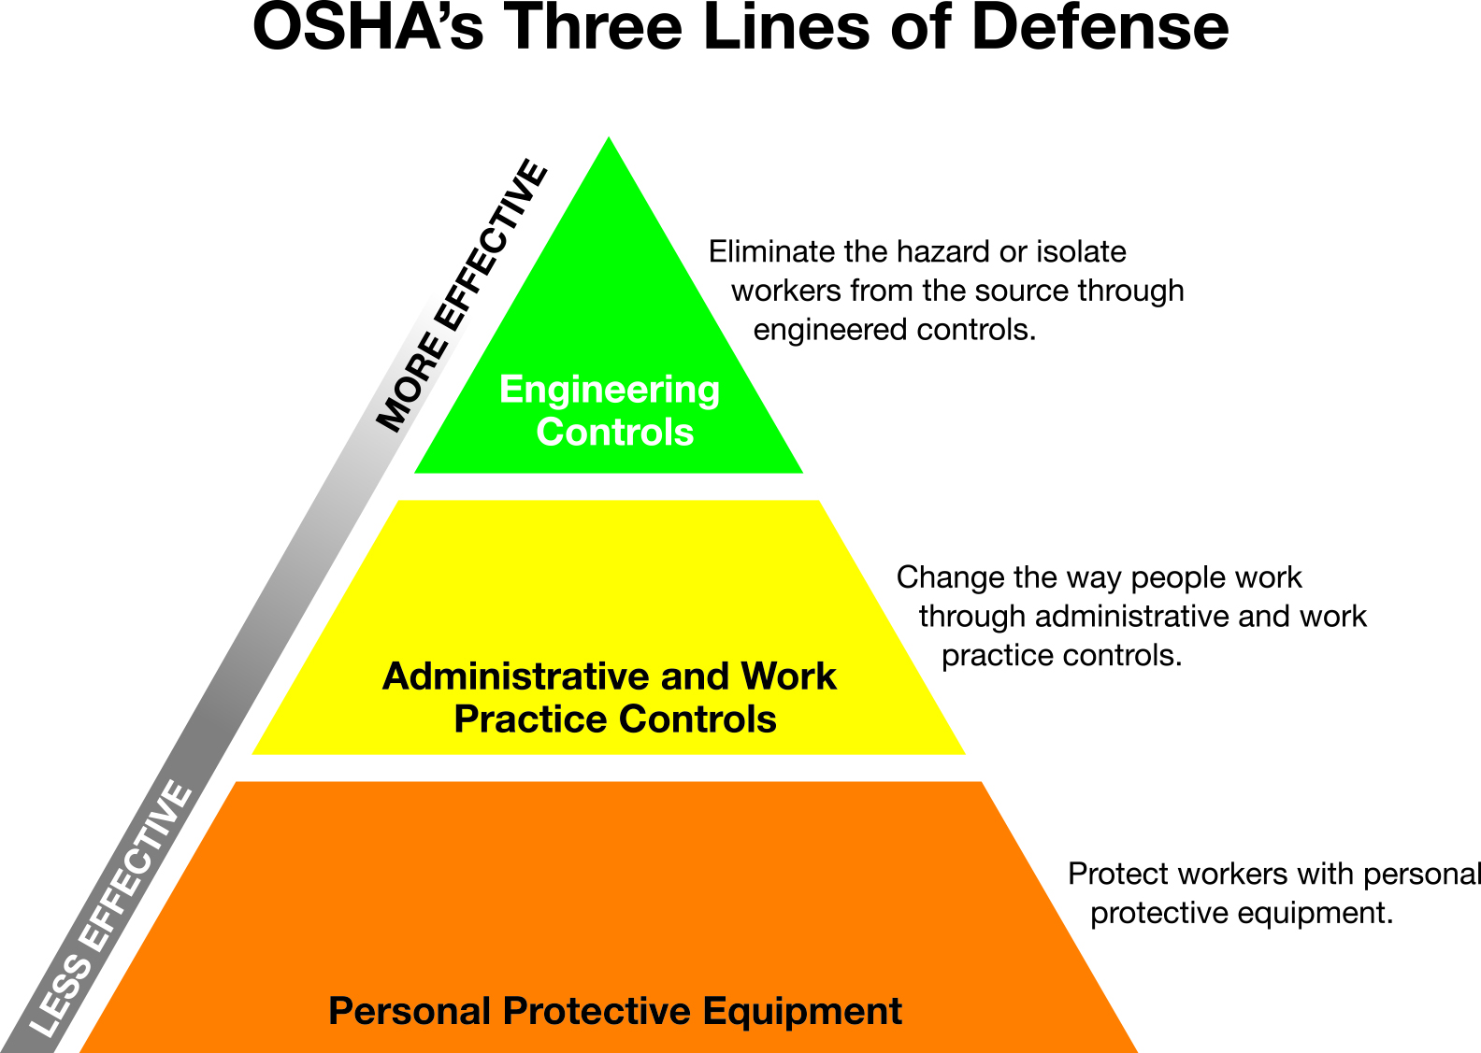
Magnetic field safety
Safety controls ⁽²⁾
Engineering Safety Controls
Should be first line of defense
Generally more reliable and should be given priority
Administrative (Procedural) Safety Controls
The second line of defense against magnetic field hazards
Only when engineering controls are impractical or inadequate
UCSB EH&S Radiation Safety Office

Slide 13
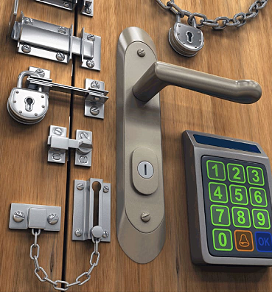
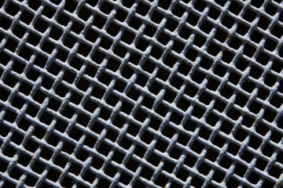
Magnetic field safety
Engineering Controls
Access Control – Prevents access to magnetic fields in excess of 5 gauss. Magnetic fields outside must be below 5 gauss
Locked Room
Best option if magnetic field producing device is located in a dedicated lab
If this is not feasible or impractical, the use of safety stanchions is acceptable
Faraday Cage – Shields individuals from magnetic fields
Typically consists of a closely spaced mesh made of conducting metal (e.g. copper)
Typically installed in walls, windows, ceiling and flooring
Non-Magnetic Tools and Equipment
A strong fridge/bar magnet can be used to confirm item is non-magnetic
UCSB EH&S Radiation Safety Office

Slide 14
Magnetic field safety
Administrative Controls
Safety Signage – Posted in a conspicuous location at entrances to an area in excess of 5 gauss to warn them of the hazards
Safety Screening – Before entering an area in excess of 5 gauss, individuals must ensure they do not have any medical implants capable of being affected by magnetic fields, or ferromagnetic items (e.g. tools, keys, jewelry, equipment, etc.)
5 gauss Line – Typically a caution line on the floor that marks the area in excess of 5 gauss
Magnetic Field Safety Training – Required for everyone working in an area
UCSB EH&S Radiation Safety Office

Slide 15
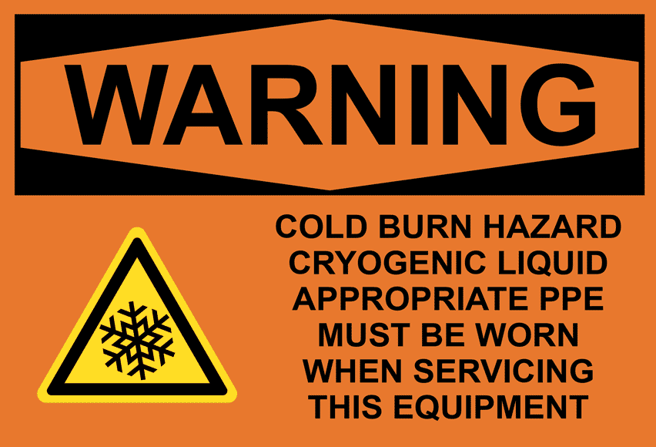
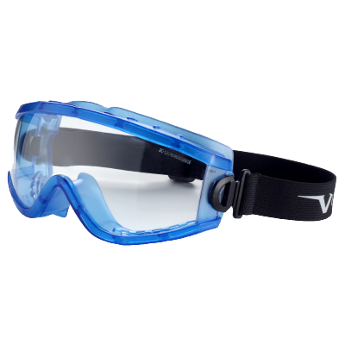
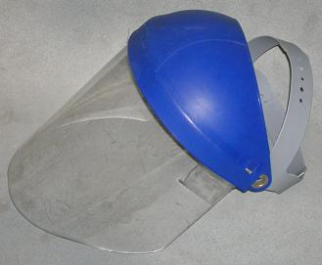
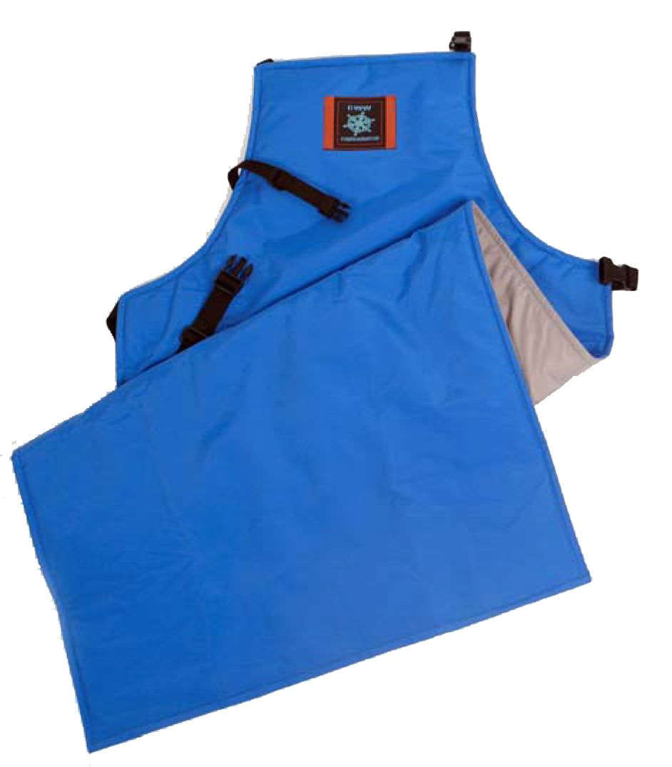
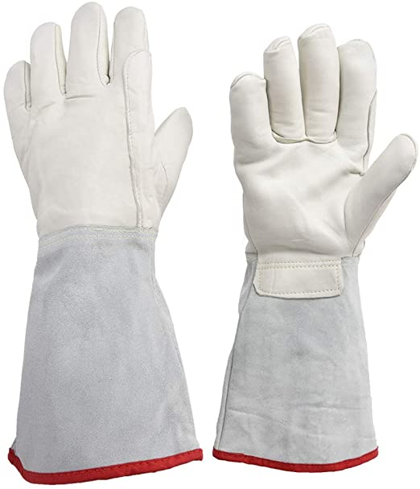
Magnetic field safety
Cryogenic safety
Cryogenic Safety
Many magnetic field producing devices require the use of cryogenic fluids such as helium and/or nitrogen which presents additional safety concerns.
When handling these materials remember to always use proper personal protective equipment (PPE).
Face shield, safety glasses or goggles
Cryogenic gloves
Body protection
UCSB EH&S Radiation Safety Office

Slide 16
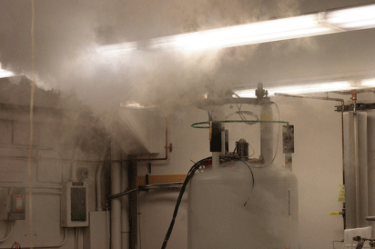
Magnetic field safety
o₂ displacement
Oxygen Displacement
When vaporized into gas, all of these liquefied gases increase many hundreds of times in volume.
Breathing in a pure inert gas environment for 5 to 10 seconds is sufficient to lose consciousness.
Longer periods of time can cause asphyxiation and death.
In some lab or space configurations, oxygen displacement is a serious concern, especially during a magnet quench.
Always store liquefied gas in well ventilated areas.
Oxygen monitoring may be required. Contact EH&S for assistance.
UCSB EH&S Radiation Safety Office

Slide 17
Magnetic field safety
Worker Responsibilities
Performs a safety screening before entering an area in excess of 5 gauss
Promptly reports any actual or suspected injury to the supervisor
Informs the supervisor and the Radiation Safety Office of any safety concerns.
UCSB EH&S Radiation Safety Office

Slide 18
Magnetic field safety
Supervisor responsibilities
Ensure that workers have completed the magnetic field safety training before giving access
Ensure that workers obtain medical care following an actual or suspected injury
Contact the Radiation Safety Office if:
Changes have been made to the facility
The magnetic field producing device is moved
If a magnetic field producing device is acquired
If an actual or suspected injury occurs
UCSB EH&S Radiation Safety Office

Slide 19
Magnetic field safety
Radiation safety office
Magnetic Field Safety at UCSB is managed by the Radiation Safety Office
The Radiation Safety Office does the following:
Performs hazard analysis
Recommends and implements safety controls
Provides safety training
Performs safety inspections
Performs accident investigation and implements corrective actions
UCSB EH&S Radiation Safety Office

Slide 20
Magnetic field safety
Injury response
If an actual or suspected injury occurs:
Do not move person unless further injury is likely.
For emergencies, call 911 (9-911 if on-campus)
Inform the Radiation Safety Office (x7255) as soon as possible.
Submit a Employee First Report (EFR) form. See Worker’s Compensation Program Website or contact 805-893-3145 for more information.
Submit a Employer Investigation (See EFR Tutorial)
Do not use the magnetic field producing device until the Radiation Safety Office has evaluated the incident and corrective actions have been taken.
UCSB EH&S Radiation Safety Office

Slide 21
Magnetic field safety
Near miss
OHSA defines a near miss as “an unplanned event that did not result in injury, illness or damage – but had the potential to do so.” A near miss is also referred to as a “close call” or “good catch.”
UCSB employees and students may use this form to report a near miss to EH&S.
EH&S will follow up to determine what corrective actions may be required to prevent a future recurrence.
Reports may be submitted anonymously if desired.
Employees are advised that it would be illegal for an employer to take any action against an employee in reprisal for exercising their rights to report safety issues.
UCSB EH&S Radiation Safety Office

Slide 22
Magnetic field safety
quiz
A misplaced or unrestrained metallic object inside of a strong magnetic field can act as a projectile moving exponentially faster towards a magnet.
a. True
b. False
2. People with implanted medical devices, such as a pacemaker, should NOT cross the 5 gauss line because it could interfere with the device’s operation.
a. True
b. False
UCSB EH&S Radiation Safety Office

Slide 23
Magnetic field safety
quiz
3. Locking the lab door to prevent access to magnetic fields in excess of 5 Gauss is considered which type of safety control?
a. Administrative Control
b. Engineering Control
4. Requiring all individuals, before entering an area in excess of 5 Gauss, to ensure they are free of any medical implants capable of being affected by magnetic fields, or ferromagnetic items (e.g. tools, keys, jewelry, equipment, etc.) is an example of which type of safety control?
a. Administrative Control
b. Engineering Control
UCSB EH&S Radiation Safety Office

Slide 24
Magnetic field safety
quiz
5. When should the Radiation Safety Office be contacted?
a. When a magnetic field producing device is acquired
b. Changes have been made to the facility or magnetic field producing device is moved
c. An actual or suspected injury occurs
d. All the above
6. What additional hazard is associated with time-varying magnetic fields rather than static fields?
a. Risk of blindness
b. Damage to credit cards
c. Induced electrical currents
d. Cancer
UCSB EH&S Radiation Safety Office

Slide 25
Magnetic field safety
quiz
7. What is the highest STATIC magnetic field exposure allowable for implanted cardiac pacemakers and the general public?
a. 1 gauss (0.1 mT)
b. 5 gauss (0.5 mT)
c. 10 gauss (1.0 mT)
d. 50 gauss (5.0 mT)
8. What is the highest 50/60 Hz magnetic field exposure allowable for implanted cardiac pacemakers and the general public?
a. 1 gauss (0.1 mT)
b. 5 gauss (0.5 mT)
c. 10 gauss (1.0 mT)
d. 50 gauss (5.0 mT)
UCSB EH&S Radiation Safety Office

Slide 26
Magnetic field safety
quiz
9. When handling cryogenic materials which items of proper personal protective equipment (PPE) should be worn?
Face shield, safety glasses or goggles.
Cryogenic gloves.
Body protection.
All of the above.
10. When using liquefied gases, what can be done to prevent O2 displacement?
a. Use and store materials in well ventilated area.
b. Always have an emergency exit.
c. Install oxygen monitors.
d. Both a and c.
UCSB EH&S Radiation Safety Office

